Slide 1


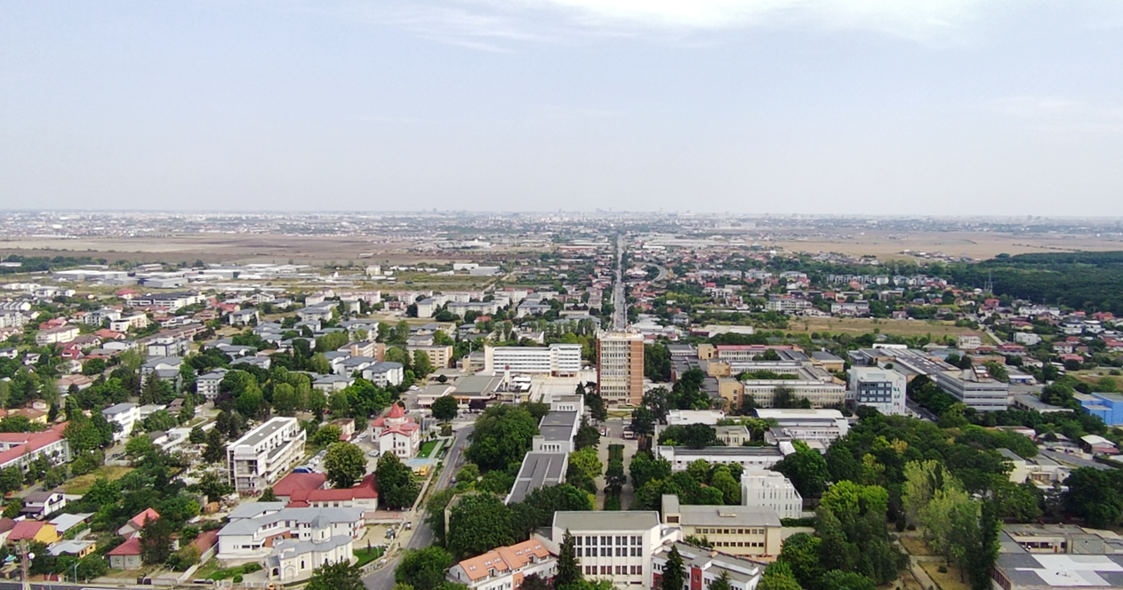
Ministry of Education and Research
National Research Authority
Institute
of Atomic
Physics
IFA@70
A success story of the Romanian scientific research
Florin-Dorian BUZATU
Măgurele, 18 May 2026

Slide 2
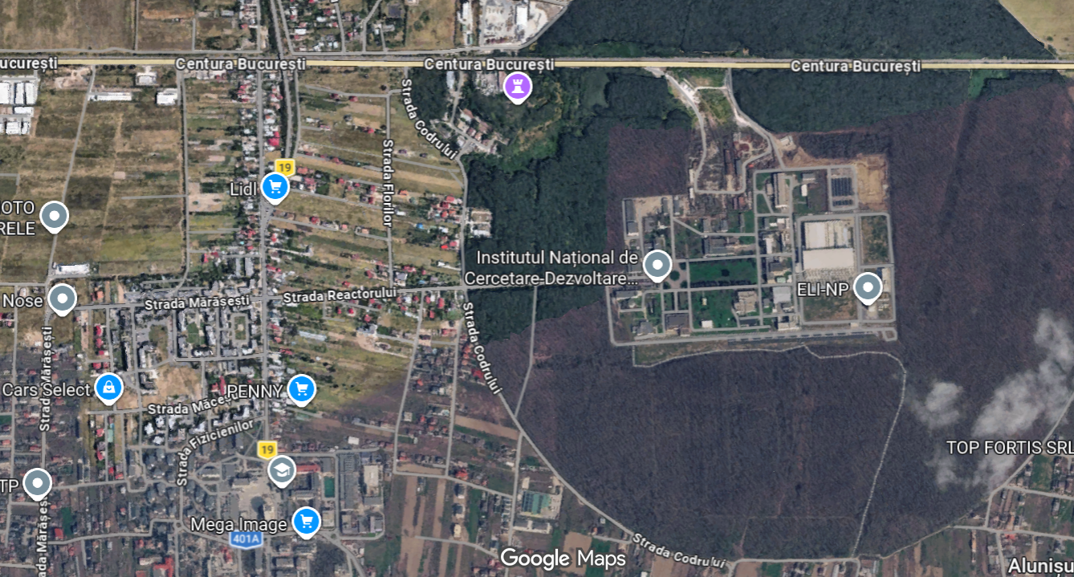
Măgurele – Pole of Physics
NUCLEAR
Facilities
9-MV Tandem
ELI-NP Laser
3-MV Tandetron
1-MV Tandetron
Radiopharm. Centre
Irradiation Facility
ELI-NP Gamma Source
Waste Treatment Plant
BUCHAREST
ring rail/road
LASERS & PLASMA
MATERIALS
EARTH
OPTOELECTRONIS
------------------
Space Sciences
Theoretical Physics
Particle Physics
Computing
Nat. Phys. Library
-------------------
UNIVERSITY (Faculty of Physics)
High School
-------------------
ENGINEERING
IFA

Slide 3
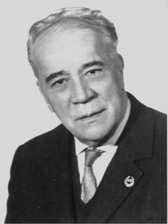
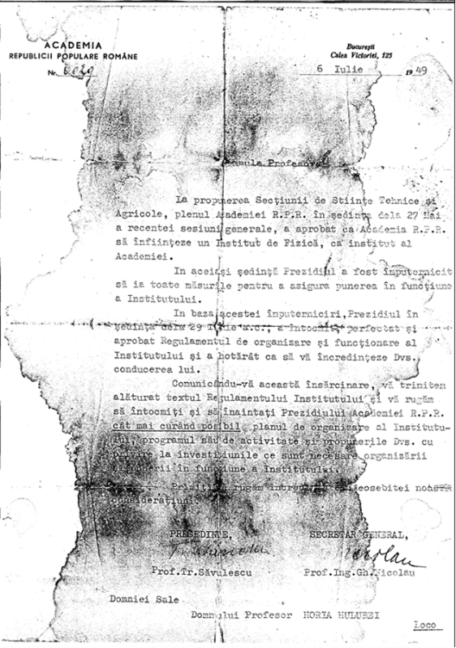
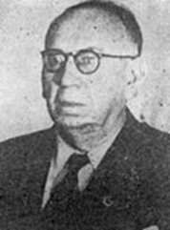
1949
Academy’s Institute of Physics
1956
Institute of Atomic Physics (IFA)
27 May: The GA of the RPR Academy approved the establishment of an Institute of Physics as an institute of the Academy.
29 June: The GA approved the Institute’s Organization Regulations and decided to appoint Professor Horia Hulubei as its director.
The Academy Institute of Physics has been located in Măgurele since its founding (September 1st?)
Horia HULUBEI
1896-1972
HCM no. 890 from 18 mai 1956:
Reorganization of the Institute of Physics of the Romanian Academy in the Institute of Atomic Physics (from Măgurele) and in the Institute of Physics (from Bucharest)
Acad. Horia Hulubei - Director IFA;
Acad. Eugen Bădărău - Director of Institute of Physics (IFB)
Eugen BĂDĂRĂU
1887-1975

Slide 4
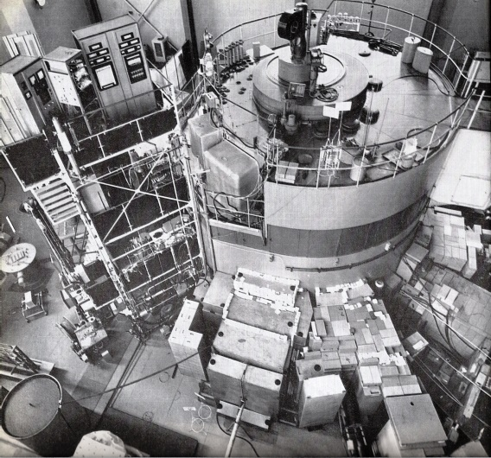
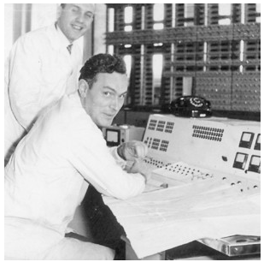
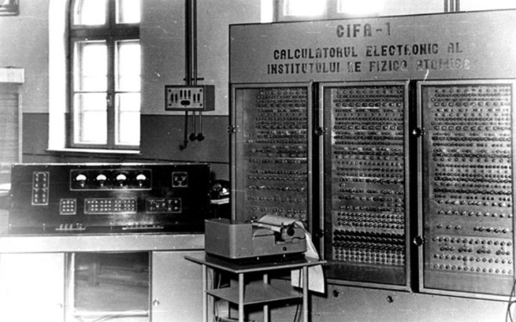
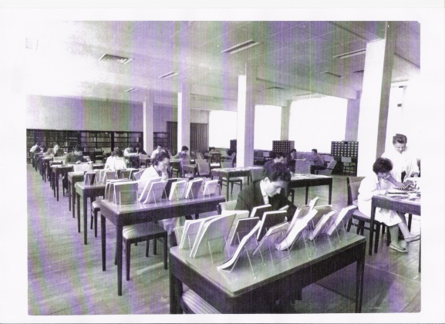
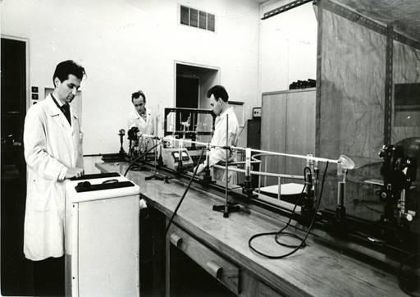
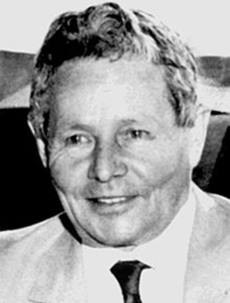
Outstanding Achievements – Romanian scientific breakthroughs
Victor Toma
VVRS Reactor (URSS/1957)
U120 Cyclotron (URSS/1957)
CIFA-1 Calculator (1956)
Ion Agârbiceanu
First IFA Library
IFA Betatron (1960)
He-Ne Laser (1962)

Slide 5
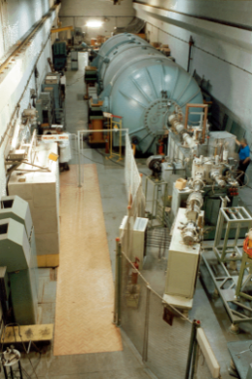
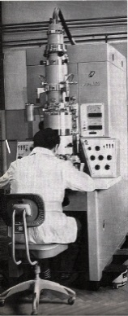
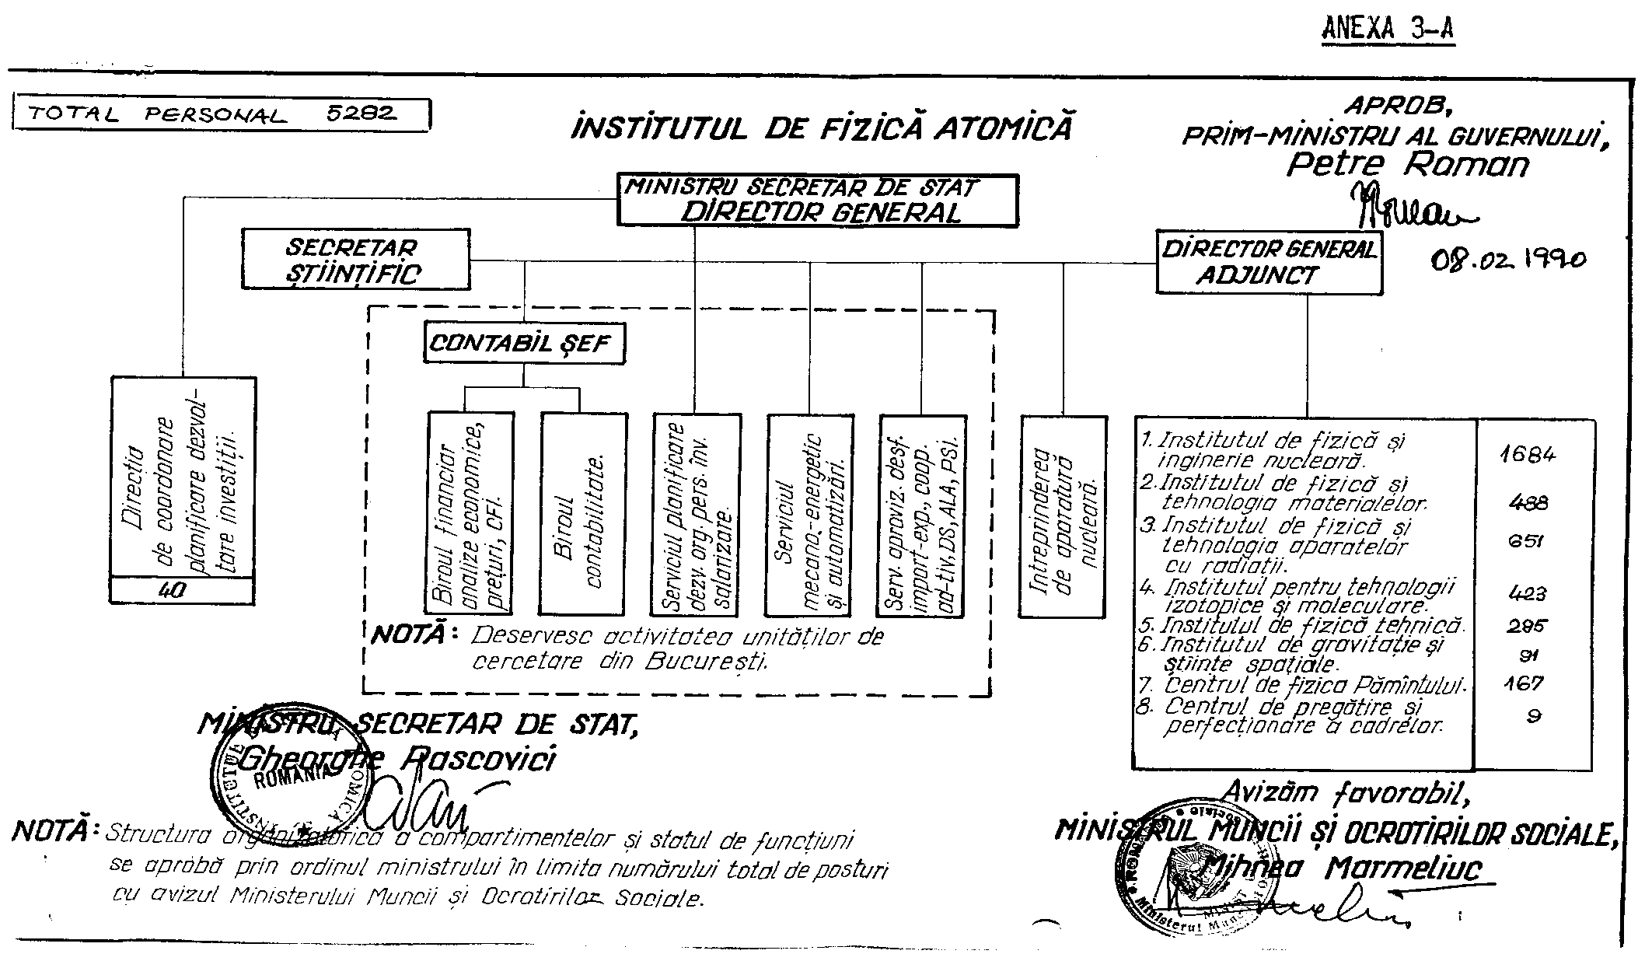
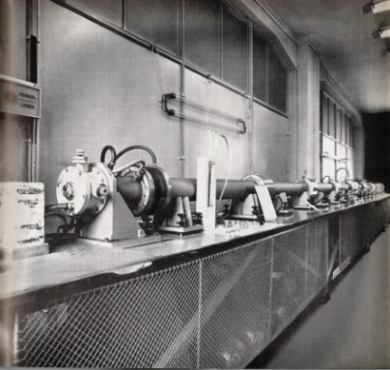
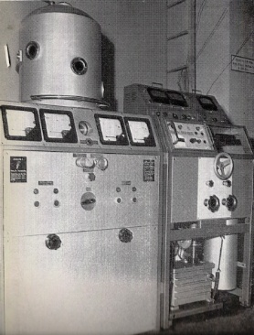
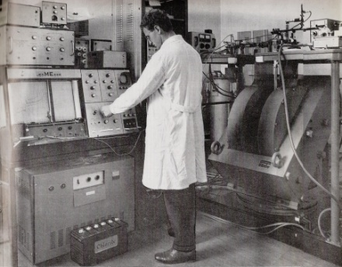
Other outstanding achievements (70s - 80s)
Short history of IFA
January 1960. The Regulation on organization and functioning of IFA, which entered into force on January 1, 1960;
June 1968. IFA is transferred from the Academy to the subordination of CEN;
December 1973. The Central Institute of Physics (ICEFIZ) is established, under the subordination of CSEN;
January 1977. IFA together with three other research units in Bucharest ICEFIZ is reorganized ceased their activity, being replaced by: IFIN, with legal personality, ensuring ICEFIZ structure, IFTM IFTAR, CASS, CFP and the Nuclear Equipment Factory;
January 1990. According to the Decree no. 6/01.01.1990 CSEN (ICEFIZ included) is abolished and IFA is re-established; February 1990. By the Government Decision (HG) no. 119/08.02.02. 1990, the organizational structure of IFA is approved;
November 1996: The INCDs are established, separating from IFA structure;
December 2008: By HG no. 1608/04.12.2008, IFA is reorganized as a public institution with legal personality, financed entirely from its own resources, subordinated to the National Authority for Scientific Research.
TANDEM accelerator
Electron microscopy
Radioisotopes production
Radioactive Waste
Treatment Plant
High-power laser
Vacuum metal deposition
Resonance spectroscopy
Neutron generator

Slide 6

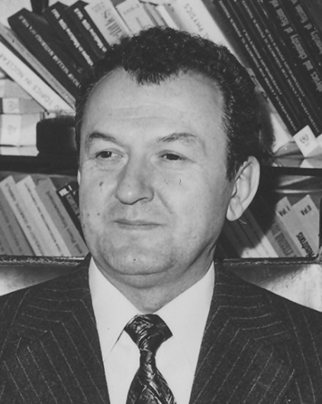
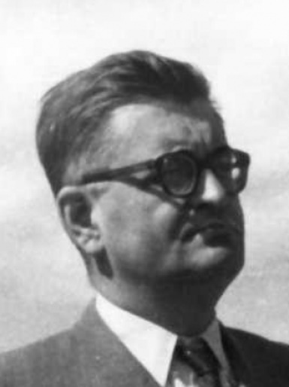
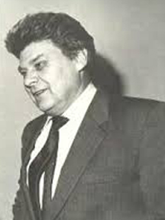
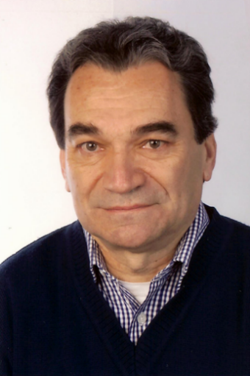
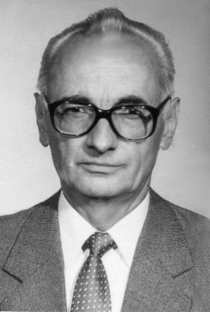
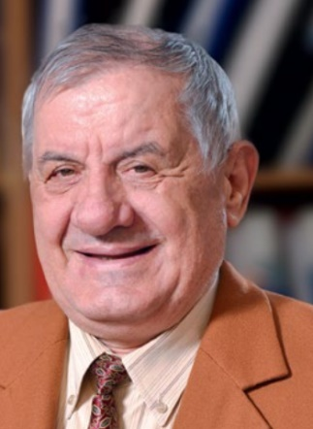
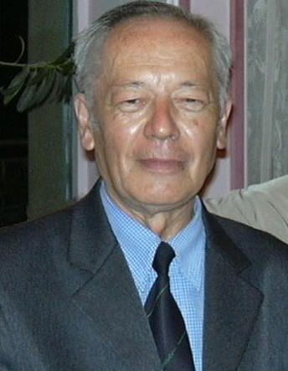
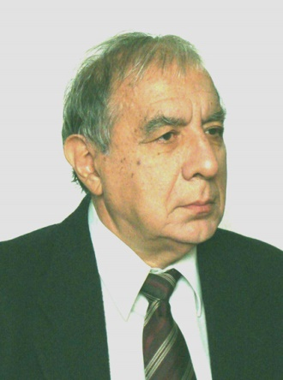
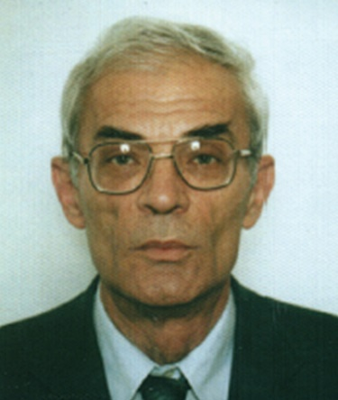
Directors general of
IFA
ICEFIZ
Horia Hulubei
1956 -1968
Ioan Ursu
1968 - 1973 – Jan. 1977
Florin Ciorăscu
Jan.- Mar. 1977
Marin Ivașcu
1978 - 1990
G. Pascovici
1990 -1993
A. Glodeanu
1993 -1995
T. Necșoiu
1995 -1997
G. Musa
1997 -1998
V. Lupei
1998 - 2000
T. Ionescu-Bujor
2000 - 2008

Slide 7
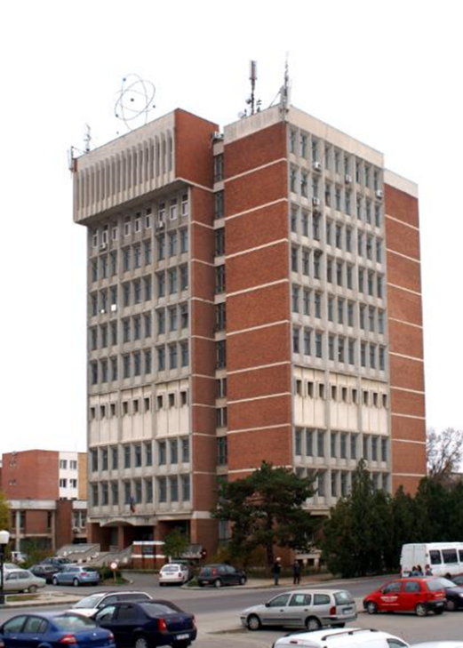
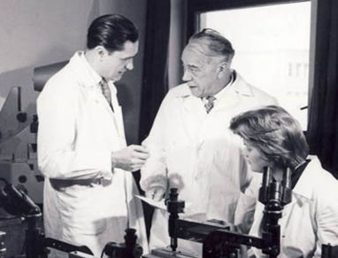
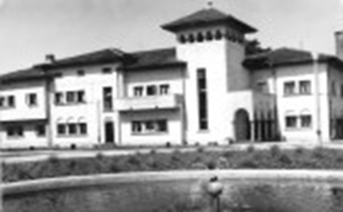
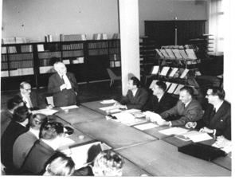
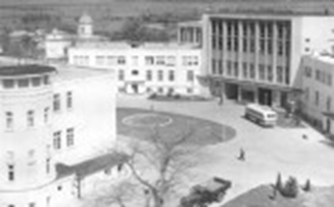
: from research to management
of research programmes
70 years
New CEA-IFA
2024 QT + MoU IFA
2022 DFG
2016 AUF & JINR
2014 ELI-NP & FAIR
2012 EURATOM Fission
2011 CERN
2010 F4E
2009 CEA-IFA / Appl. host. ELI
2008 Re-organisation
2005 CEEX (-> 2008)
1997- to date:
management of research programmes
Horia Hulubei (1896-1972)
IFA founding father
2001 CERES (-> 2006)
2000 EURATOM Fusion (CORINT)
1996 National R&D Institutes spun off from IFA
IFIN-HH, INFLPR, INFM, INFP, ITIM, IFT, ICSI
1990 IFA (CSEN, ICEFIZ -> IFA), IRNE -> Min. El. Energy
1977-1996:
central management
of research
1977 ICEFIZ (Re-organisation): IFA, IFB, CMS, Astr. Observatory
IFIN, IFTAR, IFTM, CFPS, CASS, FAN,
IRNE Pitești, ITIM Cluj-Napoca, CFT Iaşi
1973 ICEFIZ: IFA, ITN Pitești, I. Iz. St. Cluj, IFB, INCREST, Lab. Fiz. CCTF Iași
1968 IFA → CEN
1956-1976:
research
1956 IFA (Inst. At. Phys.)
IFB
1949 Inst. Phys. Acad.

Slide 8









IFA Programmes
ELI-RO (2014)
CEA-RO (2010)
EURATOM-RO (2000)
AUF-RO (2016)
F4E-RO (2010)
CERN-RO (2011)
FAIR-RO (2014)
QT (2024)
QUANTUM
TECHNOLOGIES
IFA conducts research programmes in areas of strategic interest
National Strategy for Research, Innovation and Intelligent Specialization (SNCISI) - HG 933/2022;
National Plan of RDI 2022-2027 (HG 1188/2022).

Slide 9
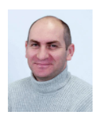
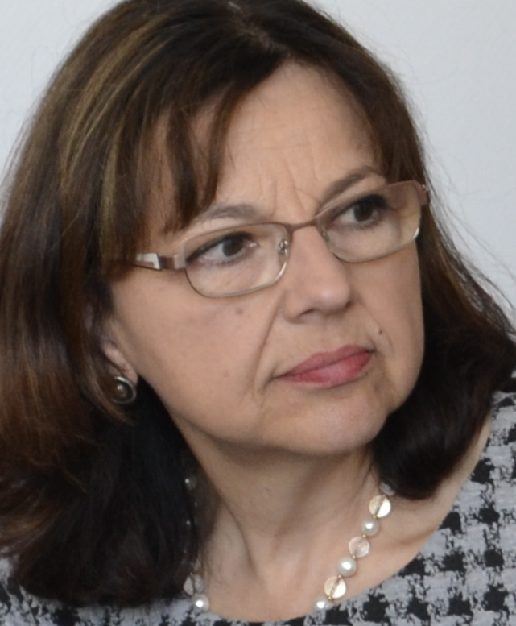
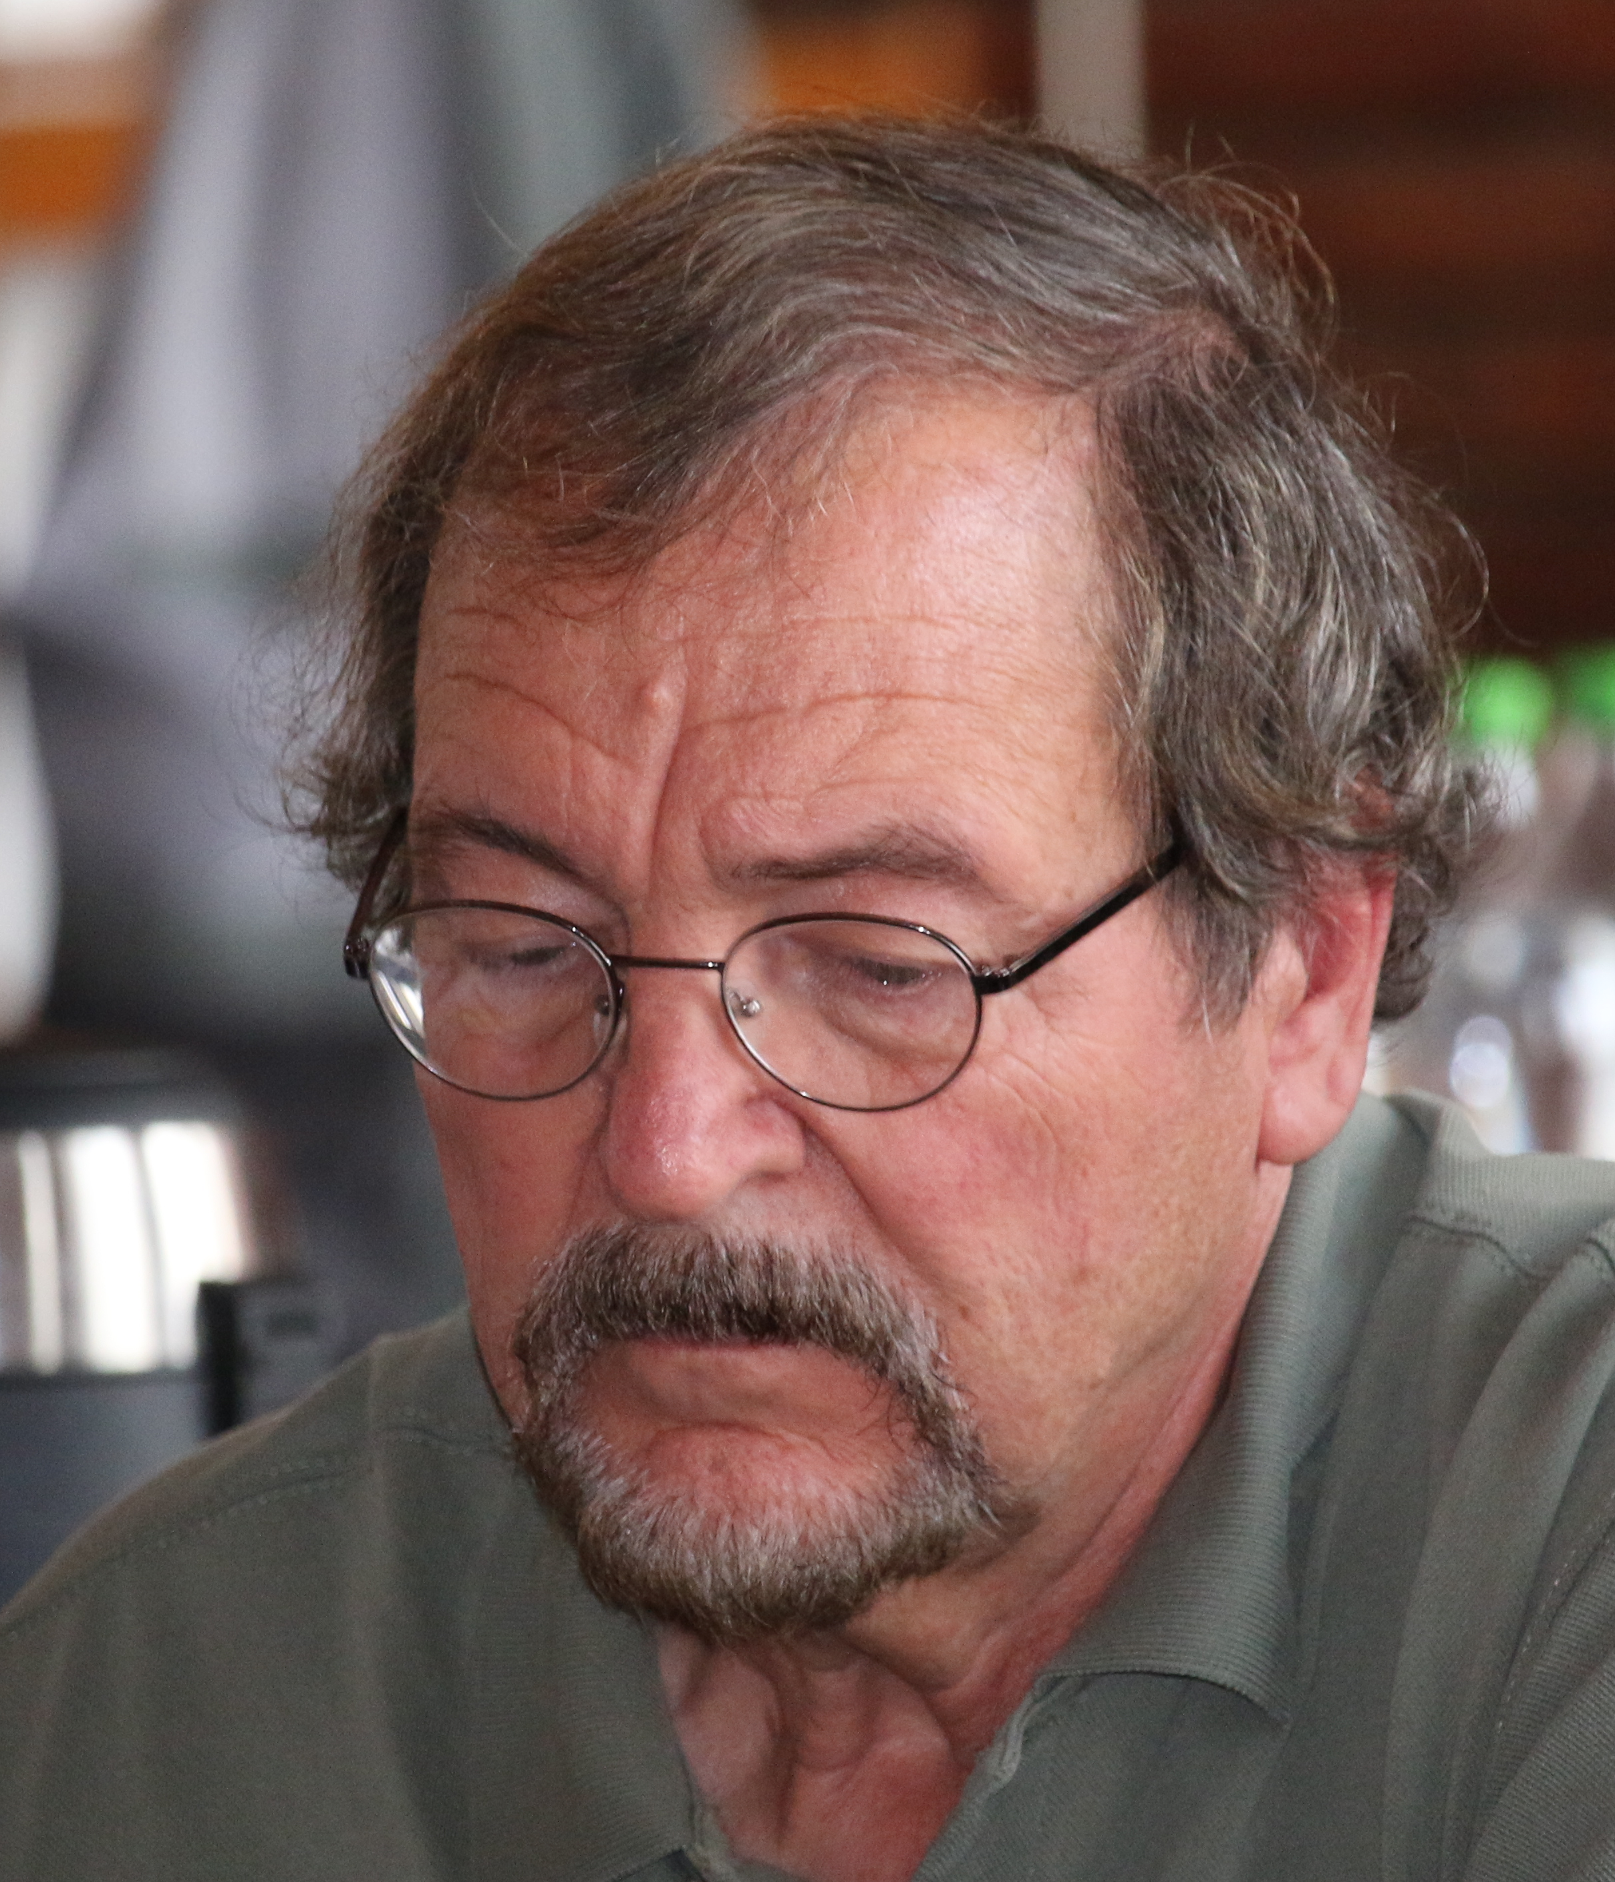
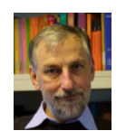
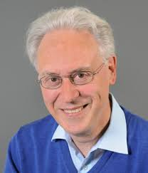
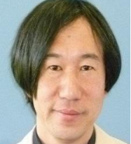
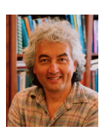
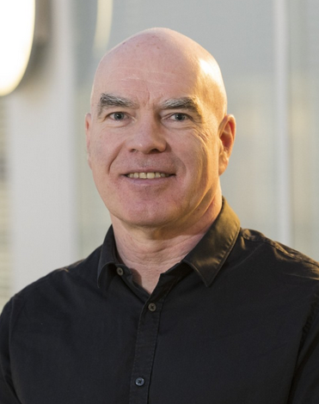
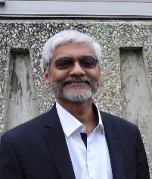
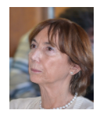
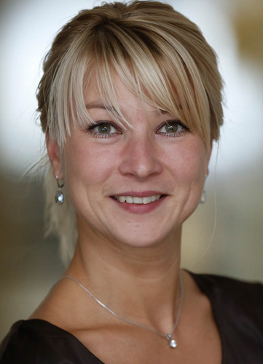
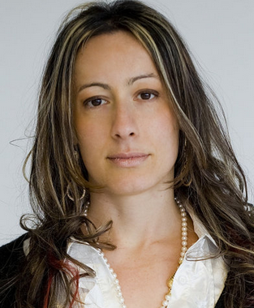
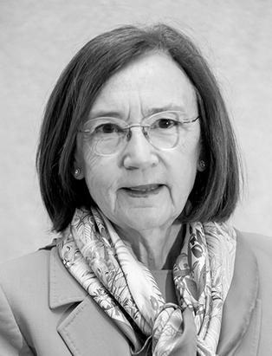
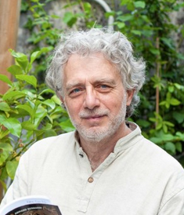
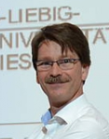
International Scientific Advisory Boards: current members
CERN-RO
FAIR-RO
ELI-RO
Dr. Cristinel DIACONU
- Chair, CPP Marseille, CNRS, France
Dr. Angela BRAEUNING-DEMIAN - Chair, GSI, Germany
Prof.Thomas KUEHL, Chair - GSI, Darmstadt, Germany
Prof. Karlheinz LANGANKE - GSI, Darmstadt, Germany
Prof. Hiromitsu KIRIYAMA - Kansai Photon Science Institute, Kyoto, Japan
Prof. Thomas LOHSE
Humbold Univ., Berlin, Germany
Prof. Zsolt Ferenc PODOLYÁK, Faculty of Engineering and Physical Sciences (FEPS), UK
Dr. Navin ALAHARI,
Grand Accélérateur National d'Ions Lourds, Caen, France
Prof. John HARRIS
Yale Univ., USA
Prof. Clara MATTEUZI
INFN, Milano Univ., Italy
Prof. Aurora TUMINO, Università degli Studi di Enna “Kore”, Italy
Prof. Tetyana Galatyuk, TUD Darmstadt, Germany
Prof. María José GARCÍA BORGE
Consejo Superior de Investigaciones Científicas / Instituto de Estructura de la Materia, Spain
Dr. James RITMAN, GSI, Germany
Prof. Dimitri BATANI
Université de Bordeaux, France

Slide 10
Budget of IFA Programmes (2000-2026)

Slide 11
Budget of IFA Programmes (2014-2025)
1 EUR ~ 5 RON

Slide 12














IFA Projects
ESFRO - Assessment of Romania’s research potential in the field of physics and the elaboration of a national strategy for international cooperation (2009-2011). Coord.: IFA, Partners: 16 institutes and universities;
ADMIFA - POS-CCE (2010) Coord: IFA
TECHDUST MARS (2013-2016)
Coord: INFLPR
STAR TECHNOLOGY (2012-2014); Coord: INCAS
STAR SCIENCE (2012-2014)
Coord: IFA
RDI National Strategy 2014-2020
(2012-2013) Coord: UEFISCDI
SCINET - Science Education Network
(2014-2017) Coord: IFA
DEXTER (2018-2021); Coord: IFIN-HH
ERAC – Research Area and Innovation Committee (2019); Coord: IFA
RECH - Research Working Party (2019); Coord: IFA
CERN Council Retreat Sinaia 2024; Coord: IFA
RISE – Ionizing Radiation – Experimental Session; (2025-2026); Coord: IFA
Coord: Max-Planck-Gesellschaft zur Förderung der Wissenschaften
Researchers’ Night 2013-2020: Coord: Univ. A. I. Cuza, Iași
Researchers’ Night 2021-2026: Coord: IFIN-HH
Coord: Bundesamt für Strahlenschutz (BfS)
Coord: Autorité de Sûreté Nucléaire
et de Radioprotection (ASNR)

Slide 13
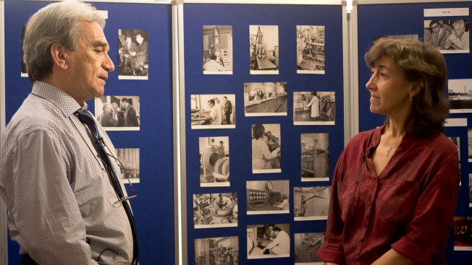
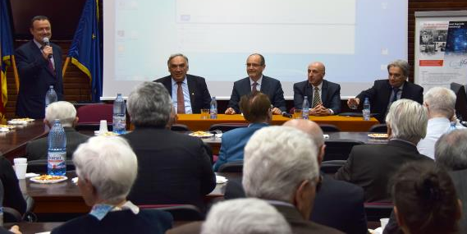
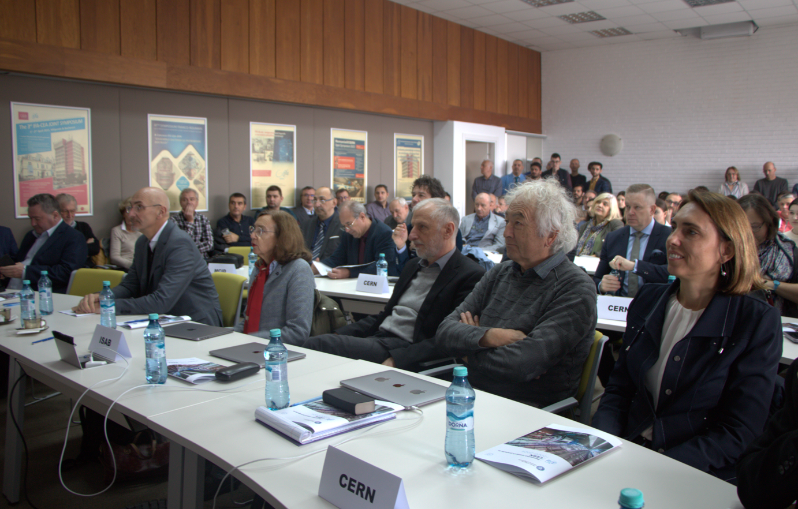
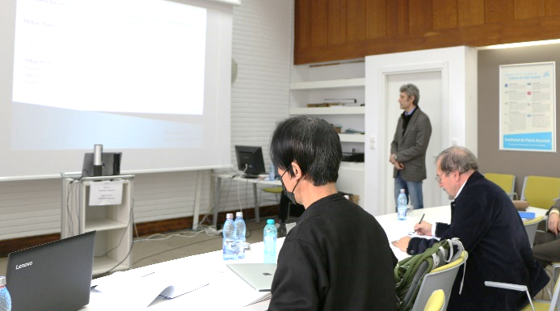











Seminars/Symposiums
IFA @60
CERN-RO
ELI-RO
FAIR-RO

Slide 14














Outreach @ IFA
ReCoNnect - Researchers’ Night & Caravan &
A different kind of School; RISE project
Petrila Caravan
A different kind of School
București, RISE
Azuga Caravan
Bărcănești Caravan
Researchers’ Night
Brașov, RISE
Beiuș, RISE

Slide 15







Brochures/Annual Reports

Slide 16
Thank You!

