Slide 1


Slide 2
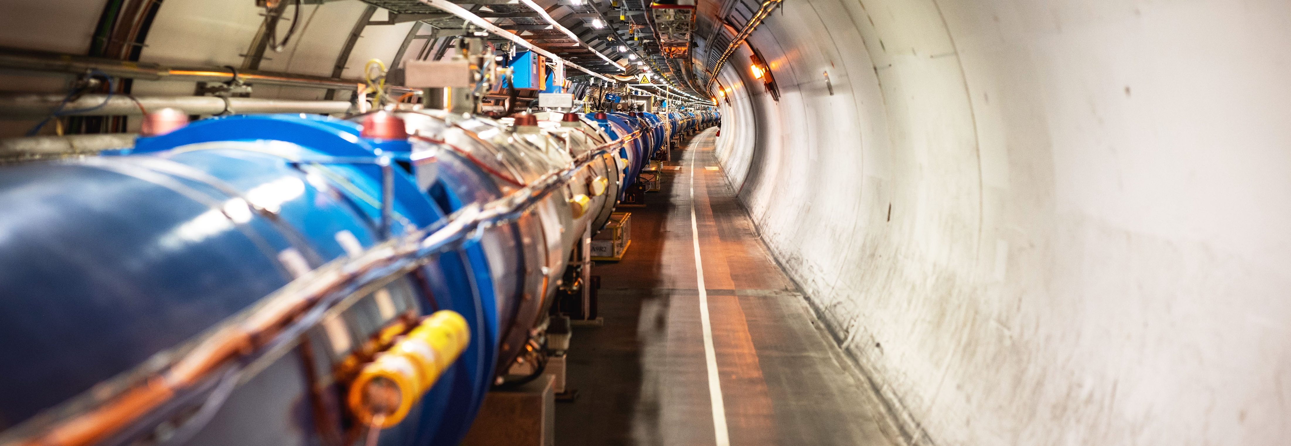
CERN’s mission
Malika Meddahi
CERN Deputy Director for Accelerators and Technology

Slide 3
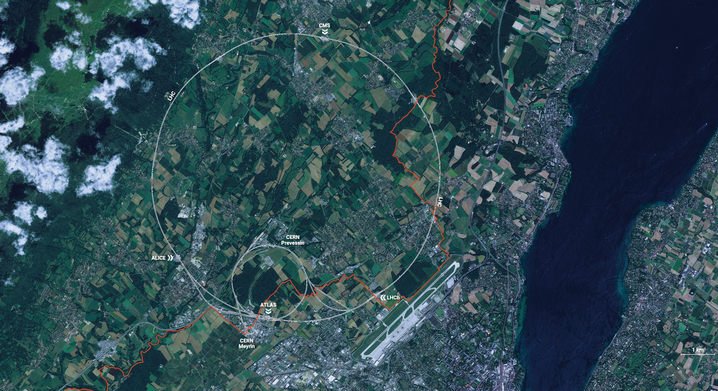
CERN is the world’s biggest laboratory
for particle physics.
Our goal is to understand the most fundamental particles and laws
of the universe.

Slide 4
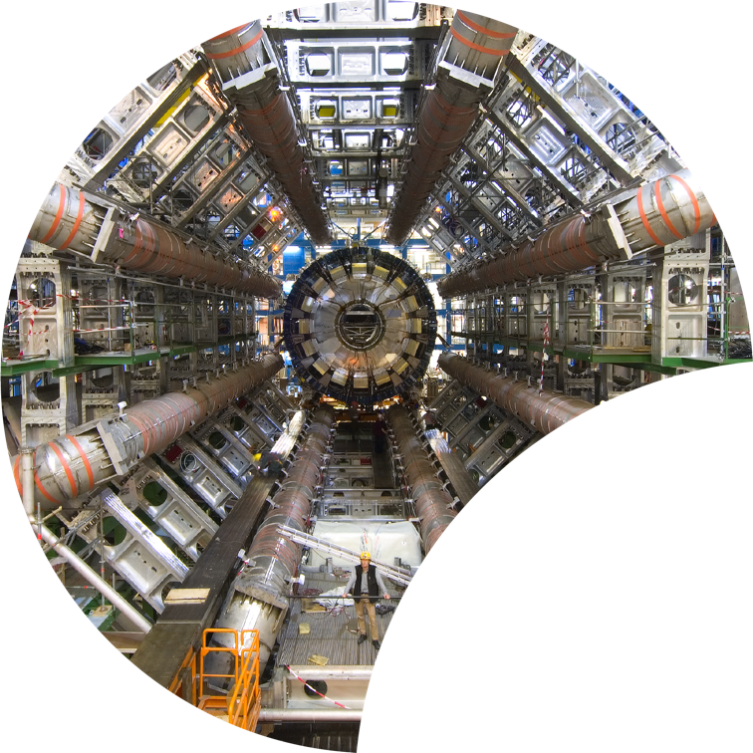
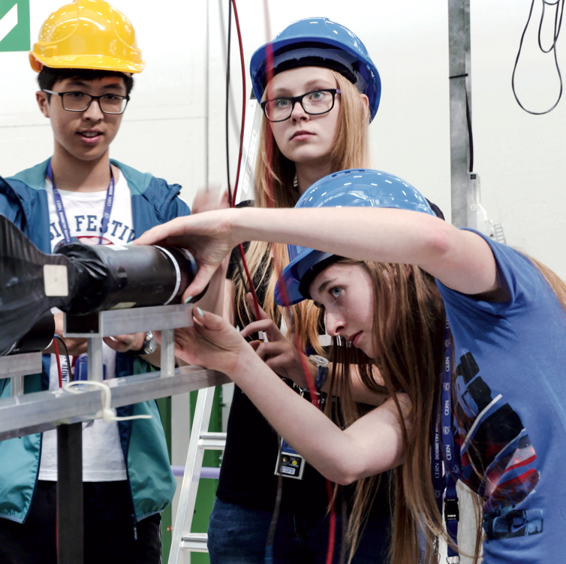
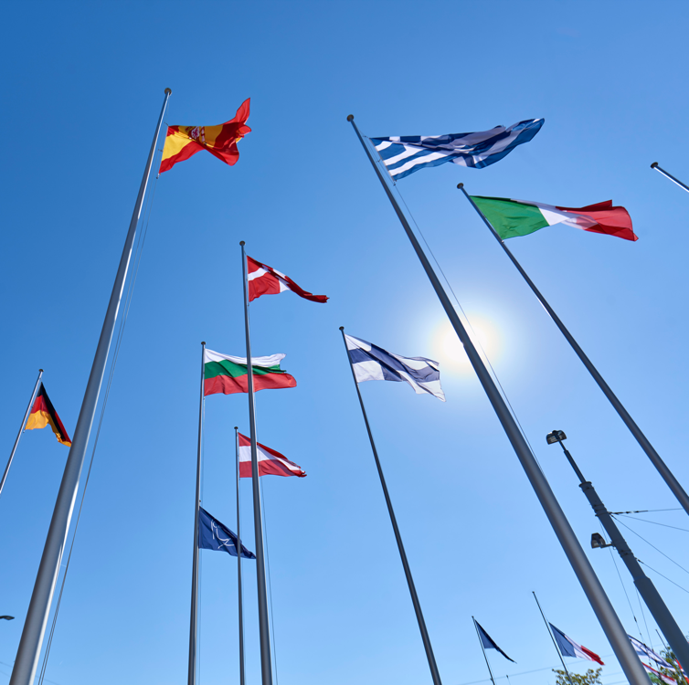
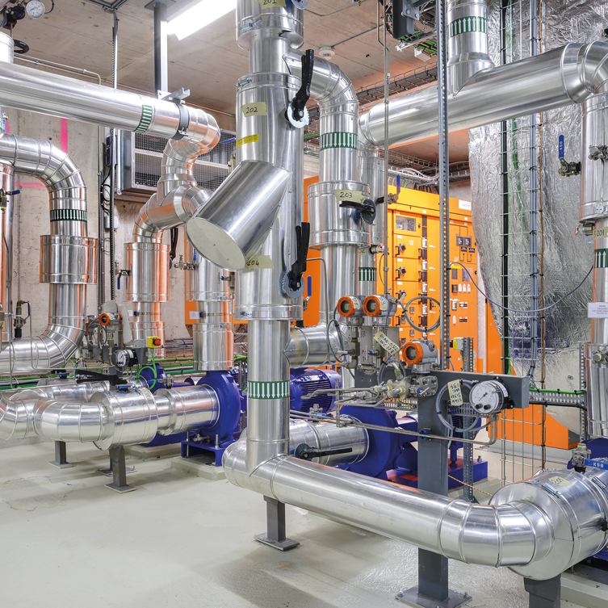

Four pillars underpin CERN’s mission
RESEARCH
EDUCATION
& TRAINING
COLLABORATION
TECHNOLOGY
& INNOVATION

Slide 5
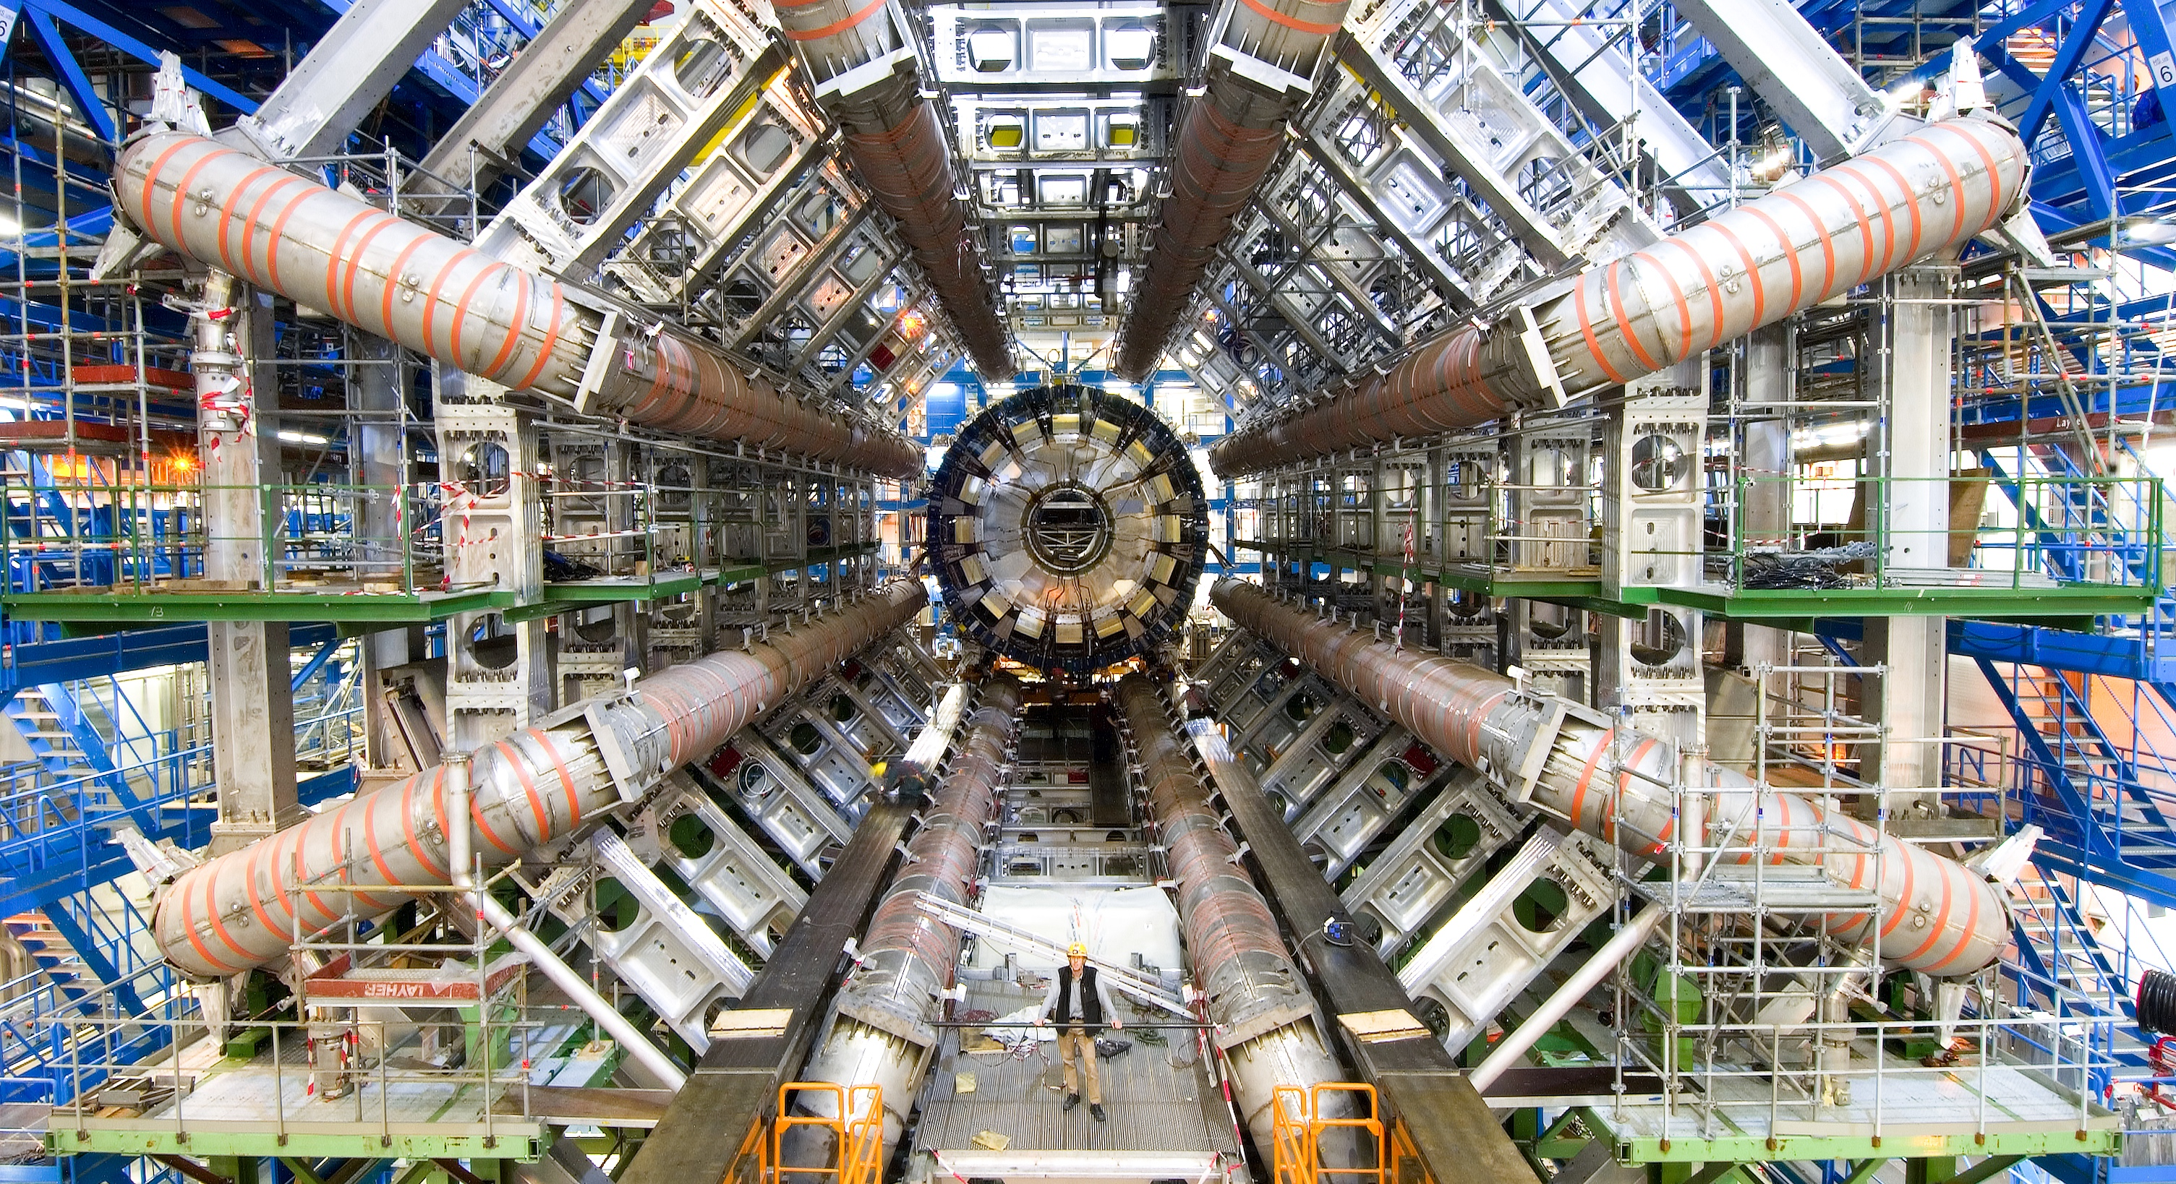
RESEARCH

Slide 6
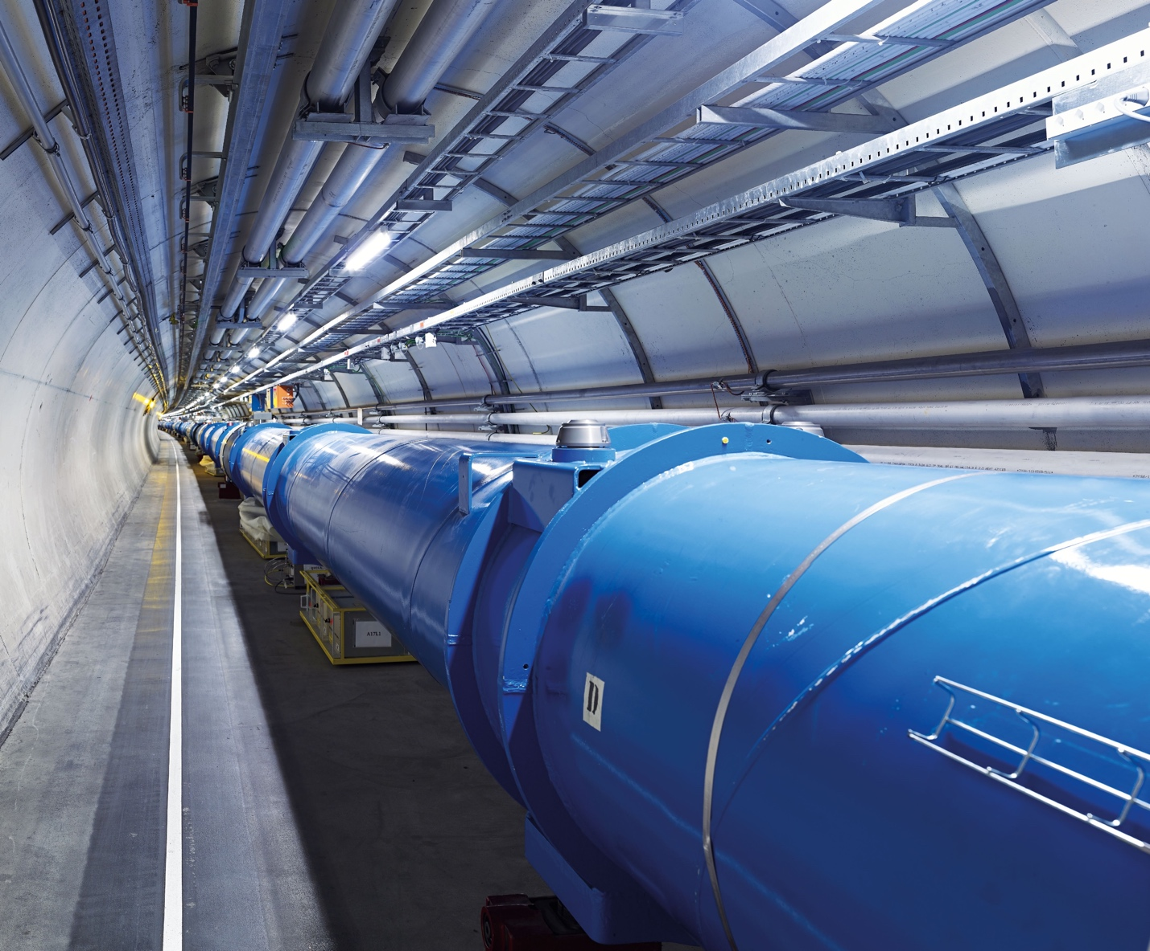
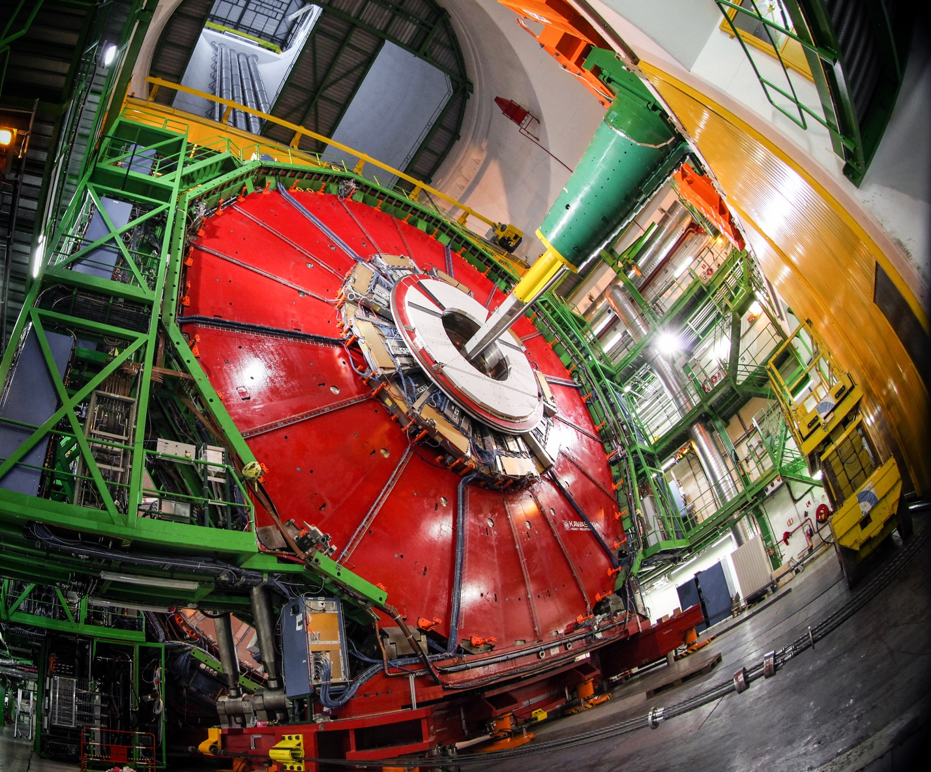
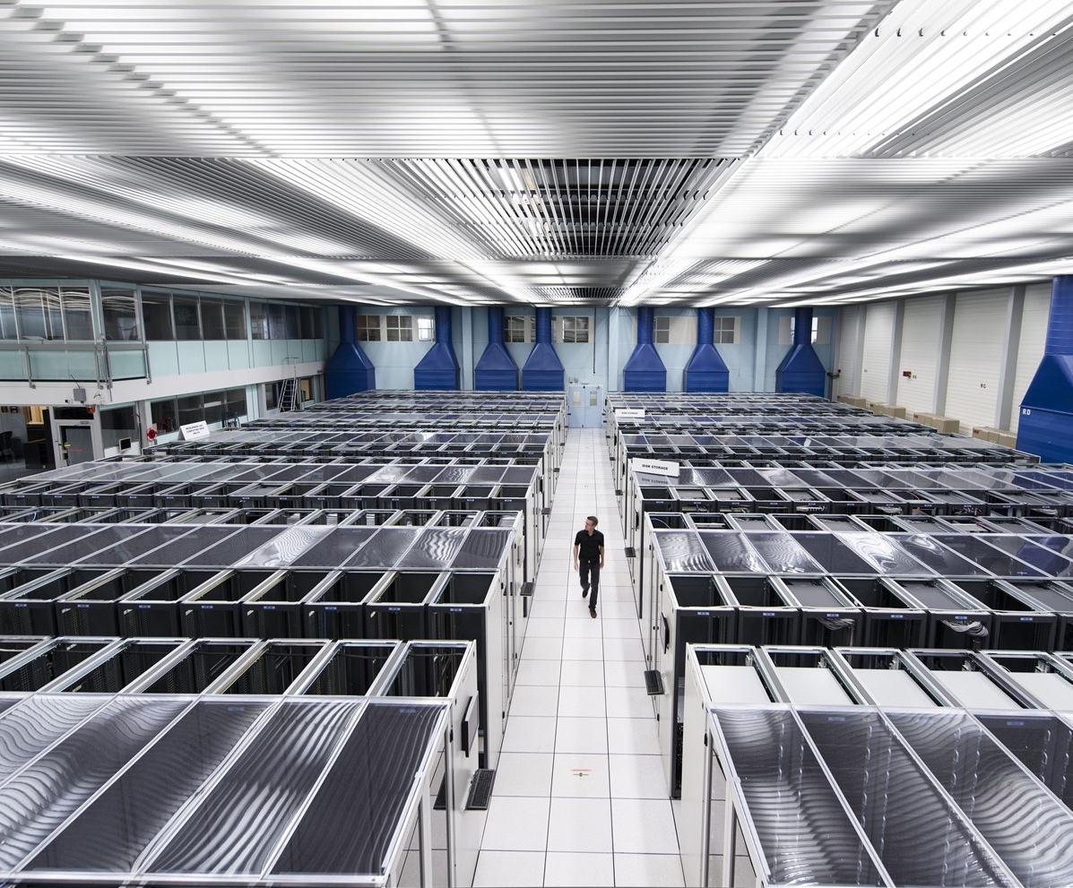
We develop technologies in three key areas
ACCELERATORS
DETECTORS
COMPUTING

Slide 7
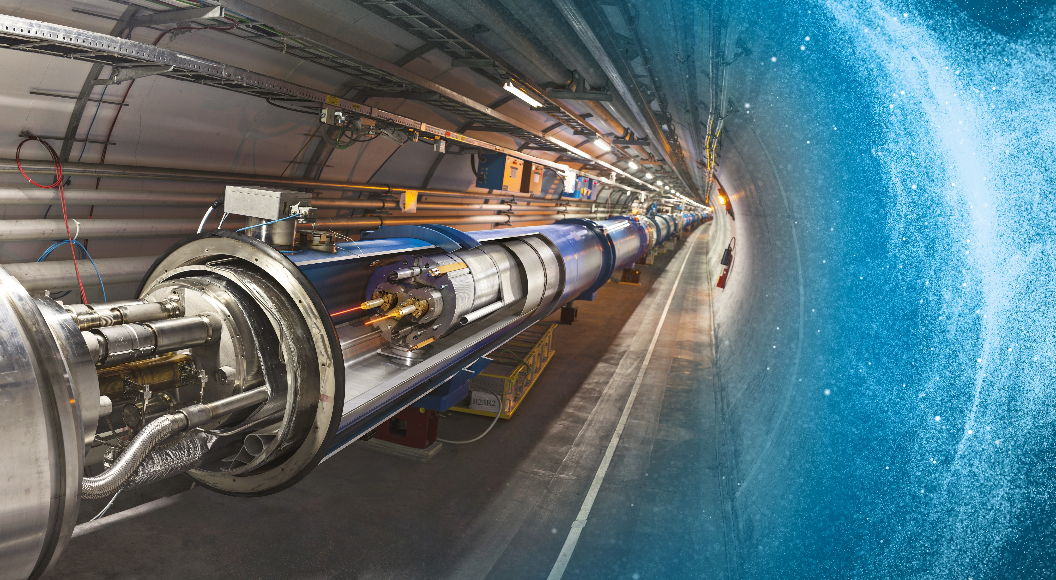
Large Hadron Collider (LHC)
27 km in circumference
About 100 m underground
Superconducting magnets steer the particles around the ring
Particles are accelerated
to close to the speed
of light

Slide 8
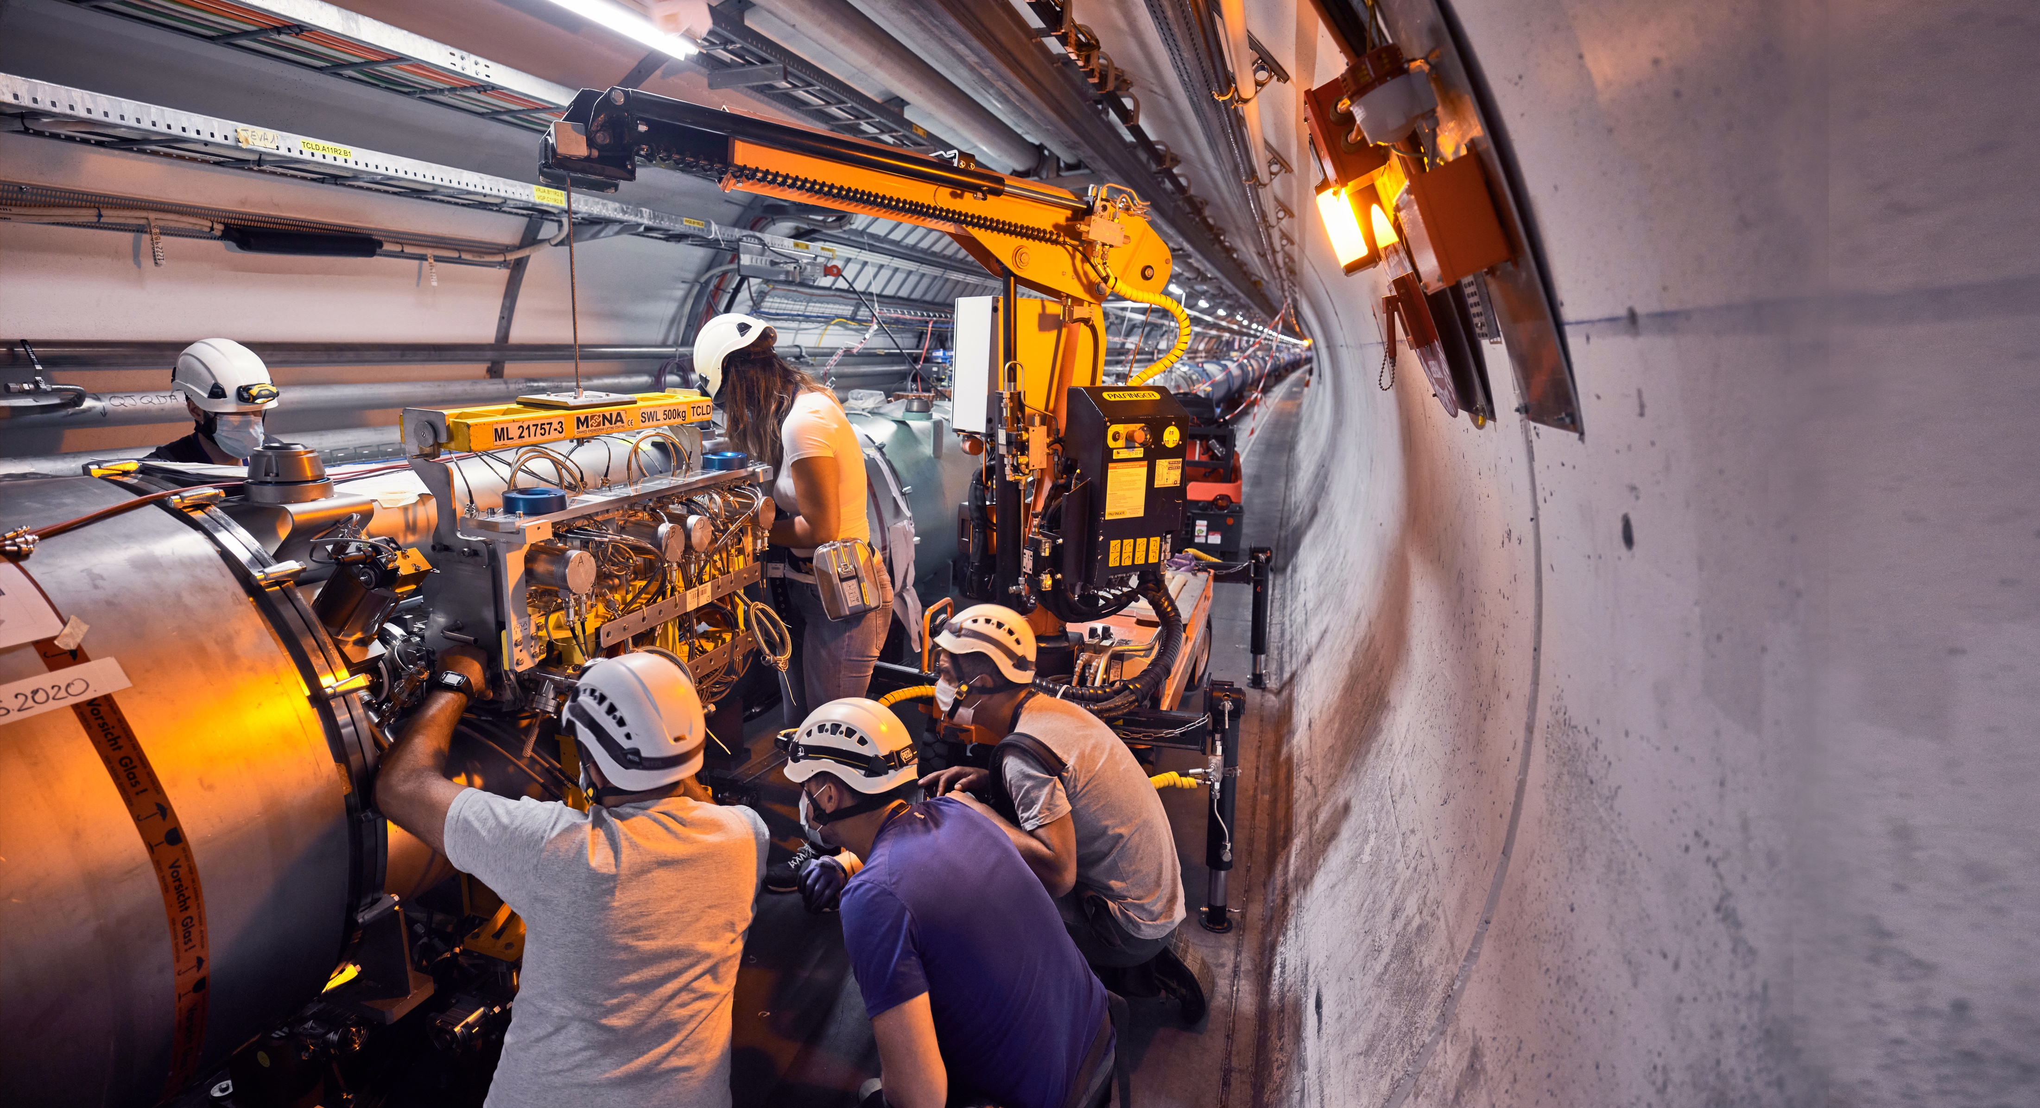
Upgrade to the
High-Luminosity LHC is under way
The HL-LHC will use new technologies to provide
10 times more collisions
than the LHC.
It will give access to rare phenomena, greater precision and discovery potential.
It will start operating in 2030, and run until 2041.

Slide 9
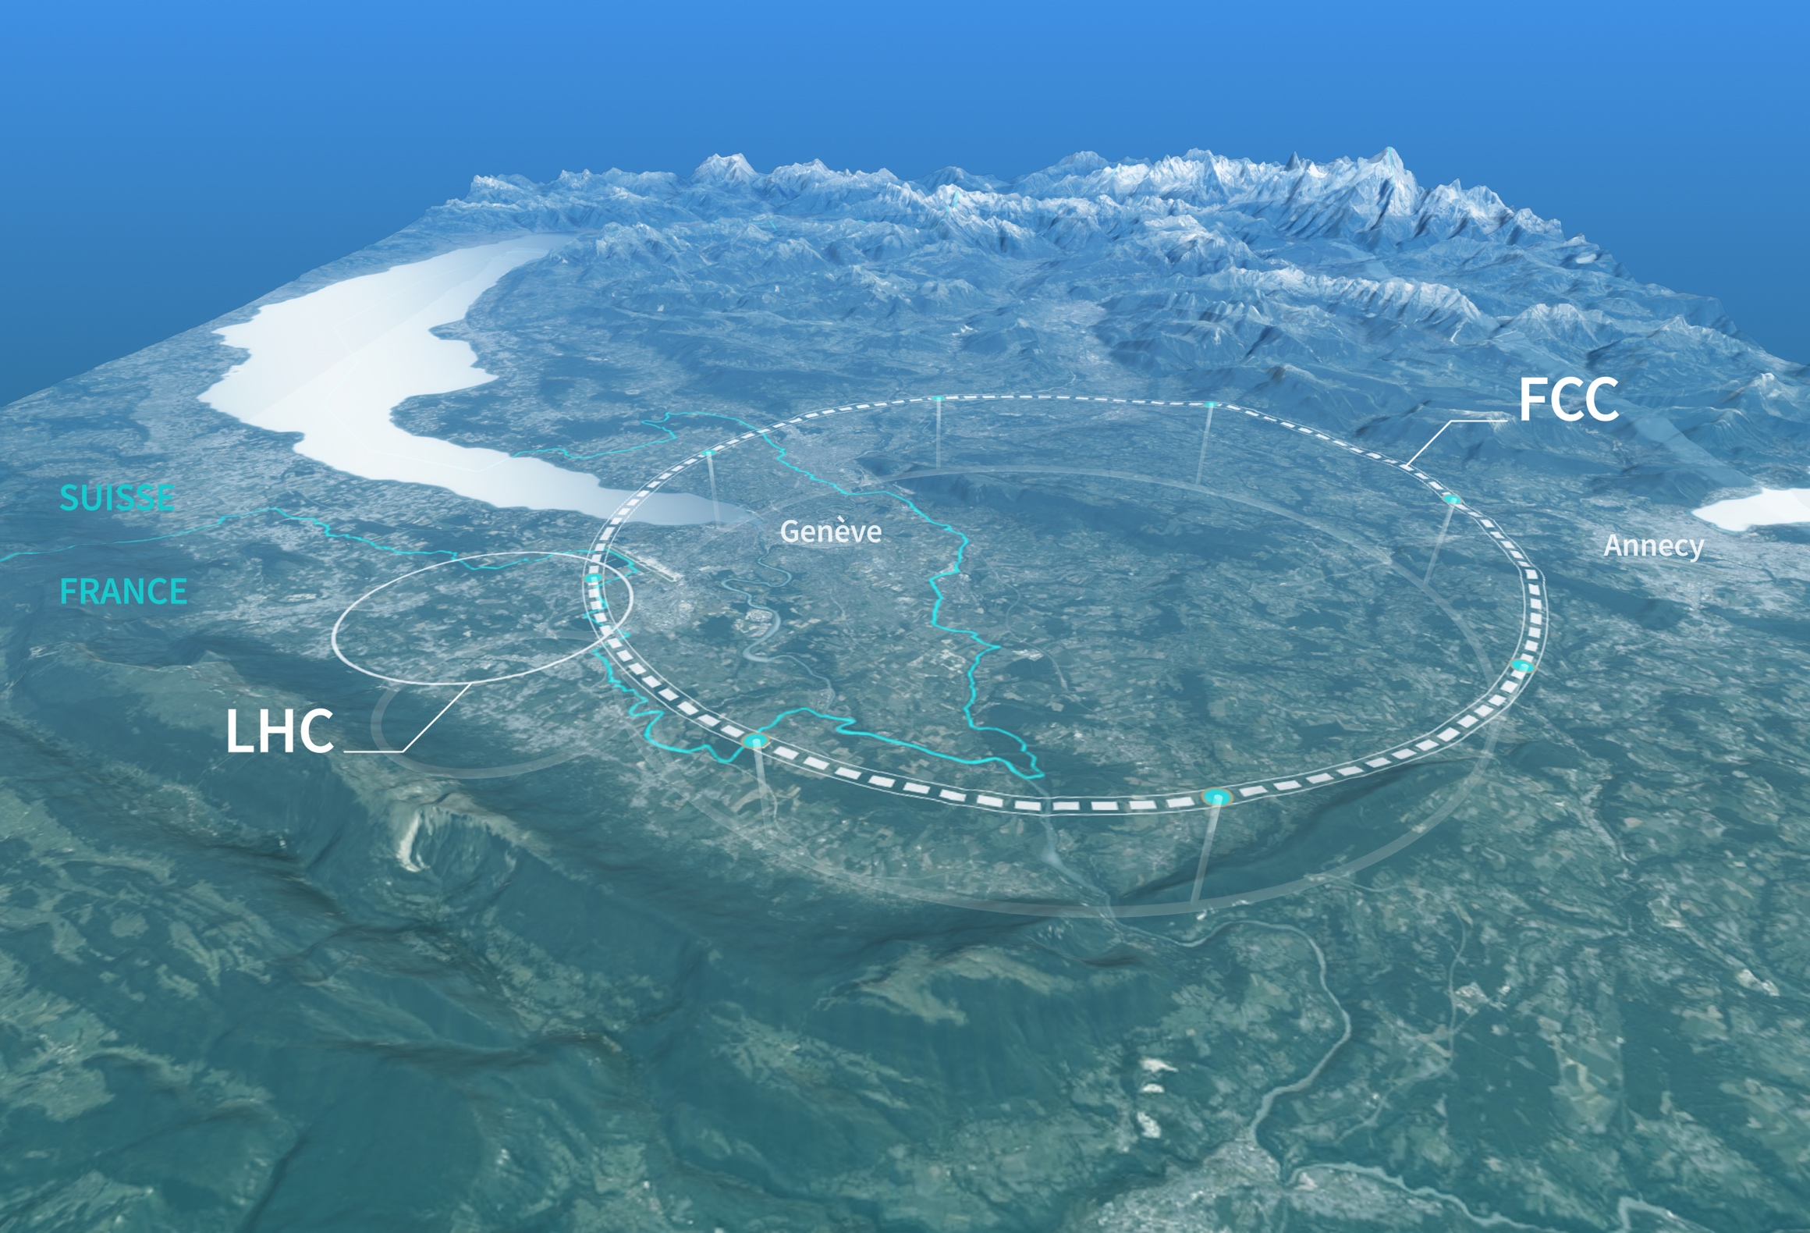
Preparing CERN’s future
Driven by the 2020 Update of the European Strategy for Particle Physics
Technical and financial feasibility study of a Future Circular Collider (March 2025)
Accelerator R&D to develop technologies for FCC and for alternative options
Detector and computing R&D
Maintain and expand a compelling scientific diversity programme
Continue to support other projects around
the world

Slide 10
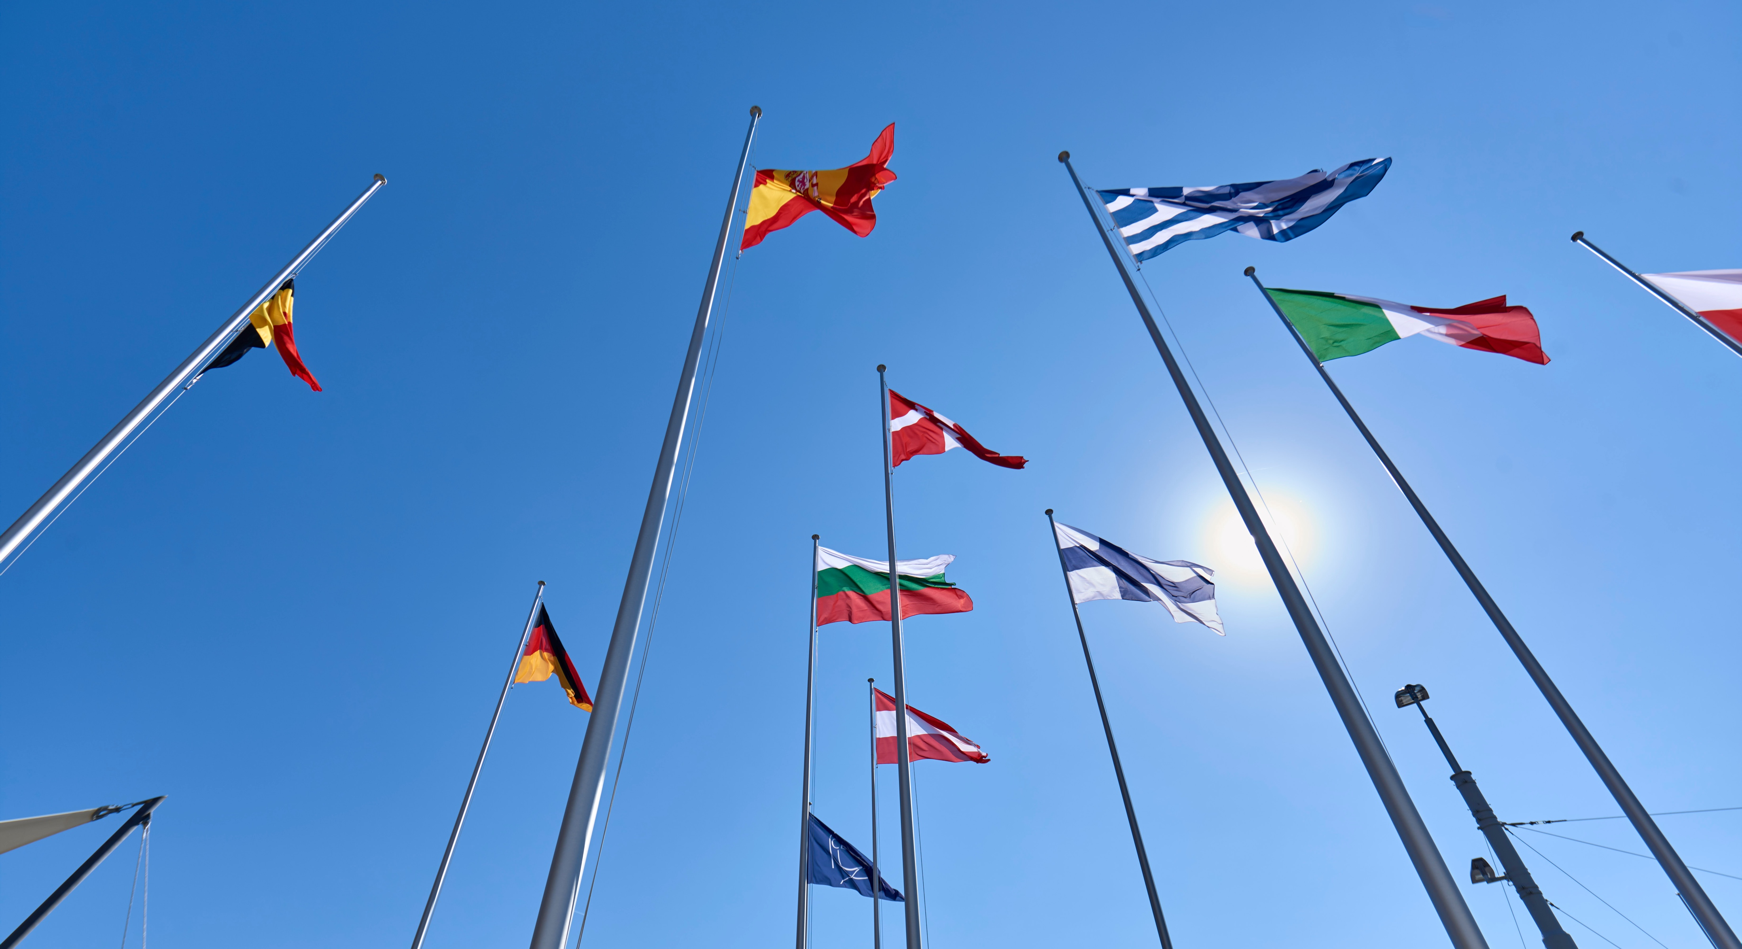
COLLABORATION

Slide 11

Science for peace
CERN was founded in 1954 with 12 European Member States
CERN’s annual budget
is 1200 MCHF (equivalent
to a medium-sized European university)
24 Member States
Austria – Belgium – Bulgaria – Czech Republic
Denmark – Estonia – Finland – France – Germany
Greece – Hungary – Israel – Italy – Netherlands
Norway – Poland – Portugal – Romania – Serbia
Slovakia – Spain – Sweden – Switzerland – United Kingdom
As of 31 December 2023
Employees:
2666 staff, 1002 graduates
Associates:
12 370 users, 1513 others
2 Associate Member States
in the pre-stage to membership
Cyprus – Slovenia
8 Associate Member States
Brazil – Croatia – India – Latvia – Lithuania – Pakistan
Türkiye – Ukraine
6 Observers
Japan – Russia (suspended) – USA
European Union – JINR (suspended) – UNESCO
Around 50 Cooperation Agreements
with non-Member States and Territories
Albania – Algeria – Argentina – Armenia – Australia – Azerbaijan – Bangladesh – Bolivia – Bosnia and Herzegovina
Canada – Chile – Colombia – Costa Rica – Ecuador – Egypt – Georgia – Honduras – Iceland – Iran – Jordan
Kazakhstan – Lebanon – Malta – Mexico – Mongolia – Montenegro – Morocco – Nepal – New Zealand
North Macedonia – Palestine – Paraguay – People's Republic of China – Peru – Philippines – Qatar – Republic of Korea
Saudi Arabia – Sri Lanka – South Africa – Thailand – Tunisia – United Arab Emirates – Vietnam

Slide 12
A laboratory for people around the world
Distribution of all CERN Users by the country of their home institutes as of 31 December 2023
Geographical & cultural diversity
Users of 110 nationalities
23.7 % women
Personnel by nationality
as of 31 December 2023
  User: 113
  Staff: 26
  Fellow: 3
  Graduate: 2
  Doctoral: 3
Numbers for Romania
Member States 7467
Austria 86 – Belgium 129 – Bulgaria 46 – Czech Republic 252
Denmark 47 – Estonia 29 – Finland 88 – France 842 – Germany 1296
Greece 112 – Hungary 80 – Israel 74 – Italy 1609 – Netherlands 167 Norway 77 – Poland 322 – Portugal 105 – Romania 113
Serbia 38 – Slovakia 67 – Spain 413 – Sweden 106
Switzerland 419 – United Kingdom 950
Associate Member States
in the pre-stage to membership 40
Cyprus 14 – Slovenia 26
Associate Member States 541
Brazil 135 – Croatia 37 – India 145 – Latvia 21 – Lithuania 17 – Pakistan 30 Türkiye 129 – Ukraine 27
Observers 3005
Japan 219 – Russia (suspended) 779 – United States of America 2007
Non-Member States and Territories 1317
Algeria 2 – Argentina 16 – Armenia 16 – Australia 26 – Azerbaijan 3 – Bahrain 3 – Belarus 14 – Canada 206
Chile 45 – China 414 – Colombia 24 – Costa Rica 3 – Cuba 3 – Ecuador 4 – Egypt 24 – Georgia 34 – Hong Kong 15 Iceland 3 – Indonesia 7 – Iran 14 – Ireland 4 – Jordan 3 – Kazakhstan 3 – Kuwait 2 – Lebanon 7 – Madagascar 1
Malaysia 4 – Malta 1 – Mexico 56 – Montenegro 3 – Morocco 18 – New Zealand 2 – Nigeria 2 – Oman 1
Palestine 1 – Peru 3 – Philippines 1 – Republic of Korea 168 – Saudi Arabia 6 – South Africa 61 – Sri Lanka 10
Taiwan 52 – Thailand 17 – Tunisia 4 – United Arab Emirates 10 – Vietnam 1

Slide 13
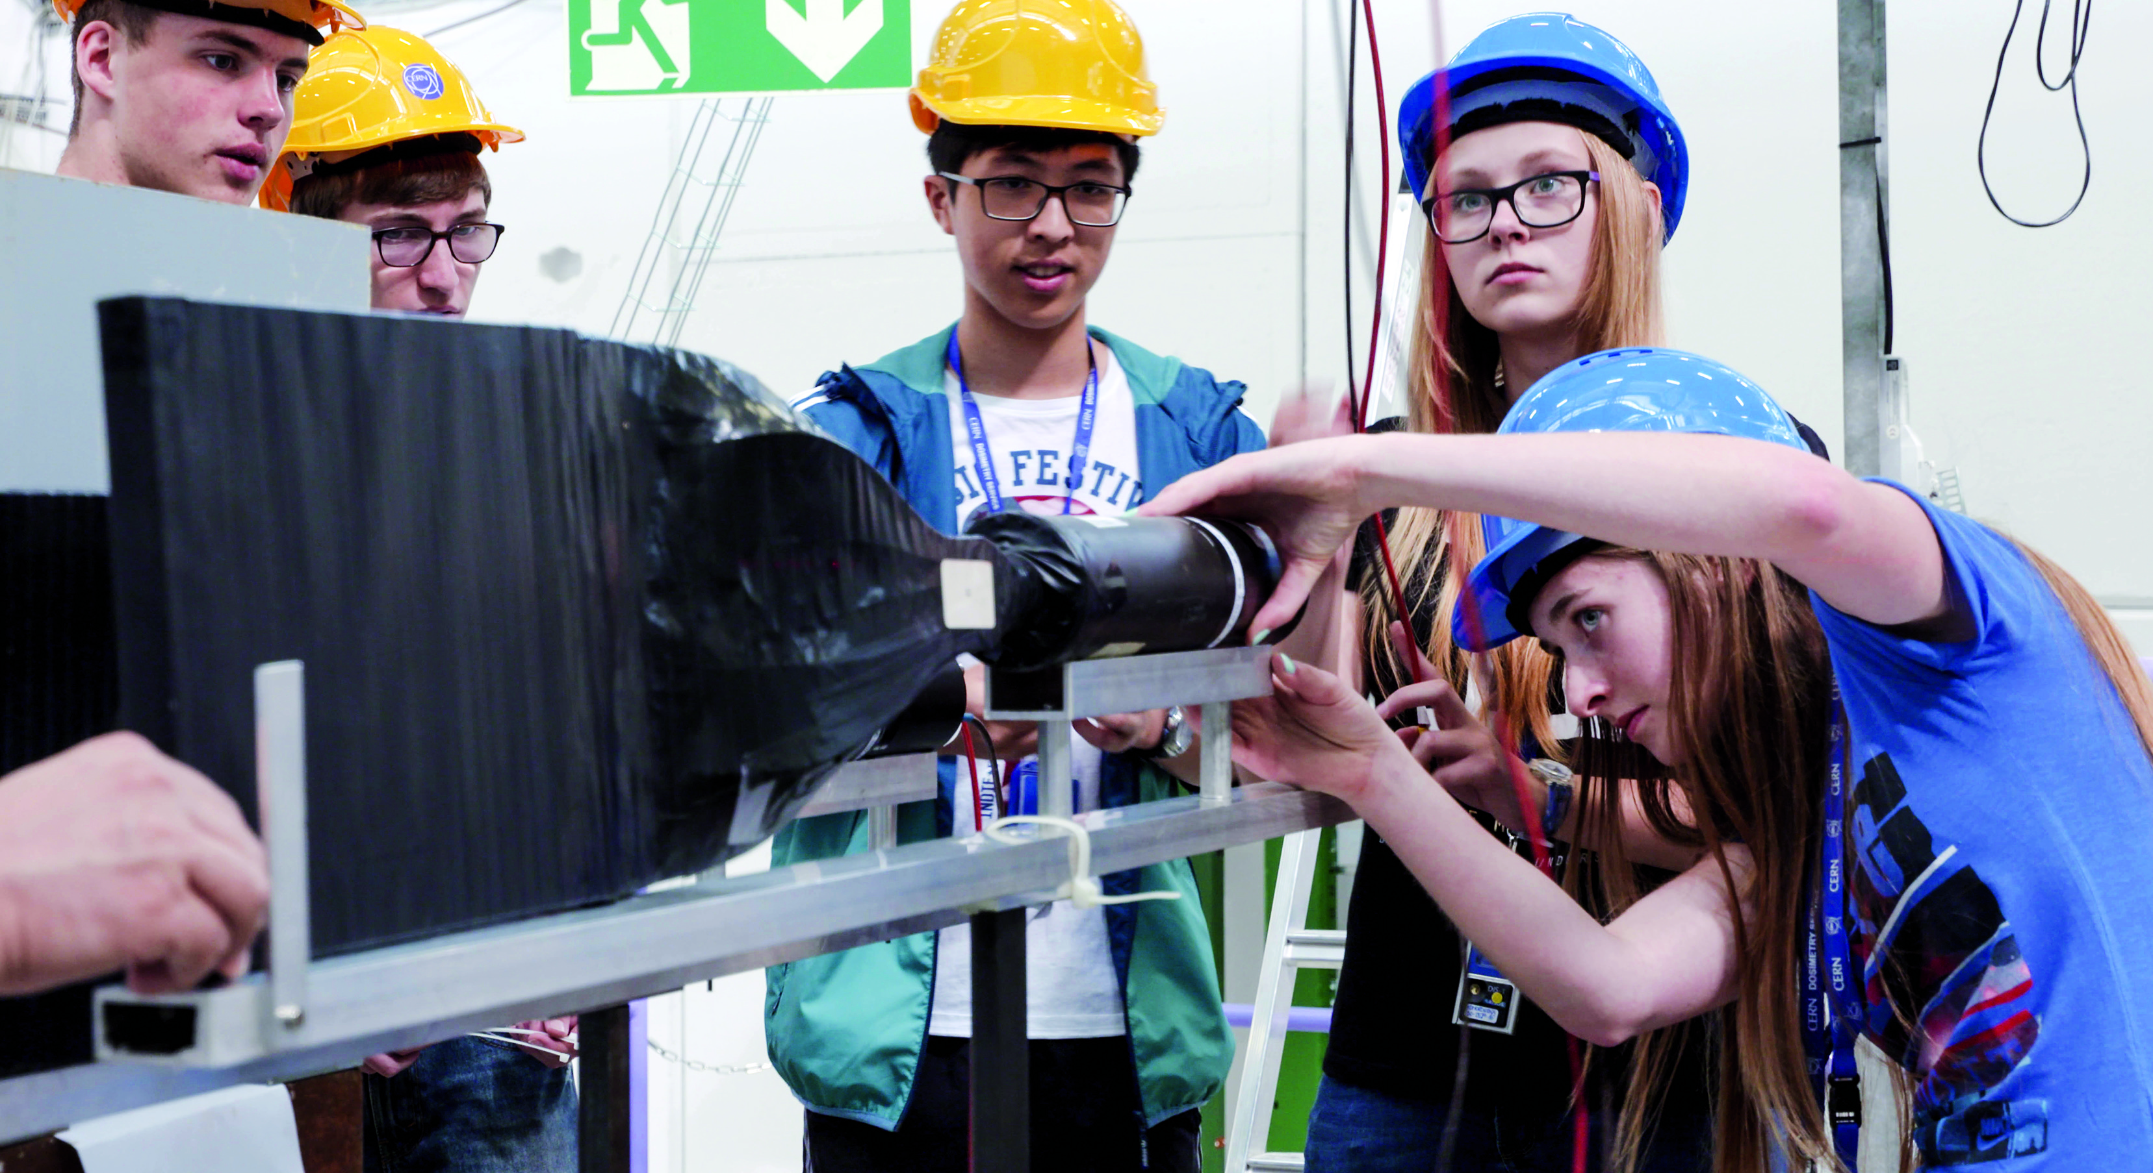
EDUCATION
& TRAINING

Slide 14
CERN opens a world of career opportunities
Number
of Persons
19%
Other fields, including
government organisations
27
45%
Industry
36%
Academia or Research
67
age
Age Distribution of Scientists working at CERN
Source: CERN Alumni survey (2014)
PhD and Technical students leaving CERN

Slide 15
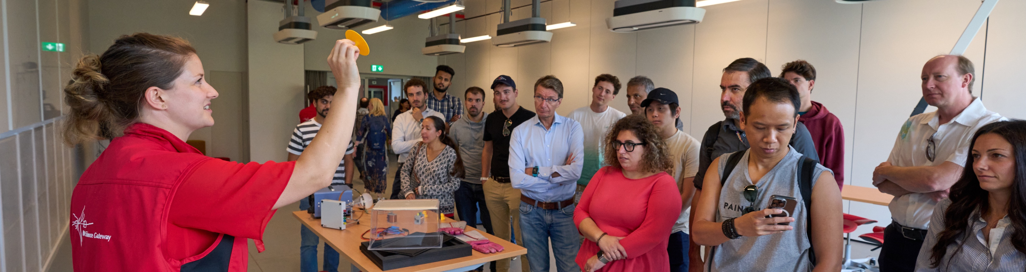
CERN’s training, education and outreach programmes
1002 graduates
(including Research Fellows)
3 000 PhD students
300 Undergraduate students in
Summer programmes
Numbers for Romania
5 summer students during 2023
21 teachers in Teacher Programmes since 1998
26 teams in BL4S competition since 2014
> 15 000 teachers participating in dedicated programmes, since 1998
Around 150 000 visitors per year on guided tours of CERN,
from >50 countries
4.7M followers on social media, from around the globe

Slide 16
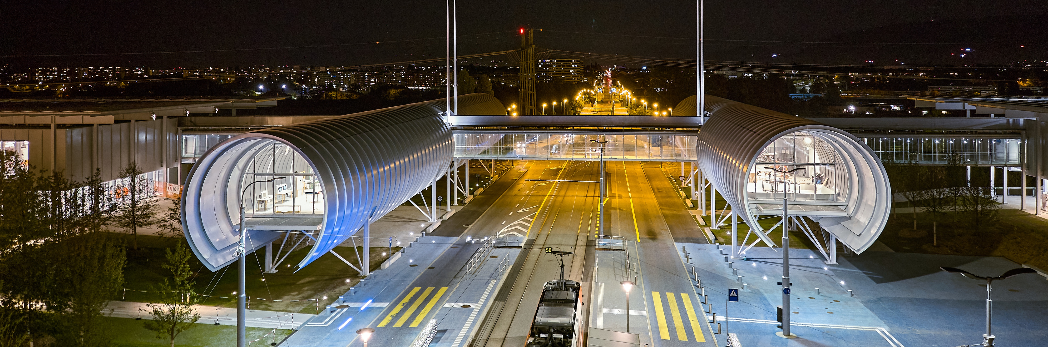
CERN Science Gateway
CERN’s new education and outreach centre for all
publics aged 5-plus.
Inaugurated
October 2023.
Number of visitors: >400 000
Immersive exhibitions, education labs, events
and shows.

Slide 17
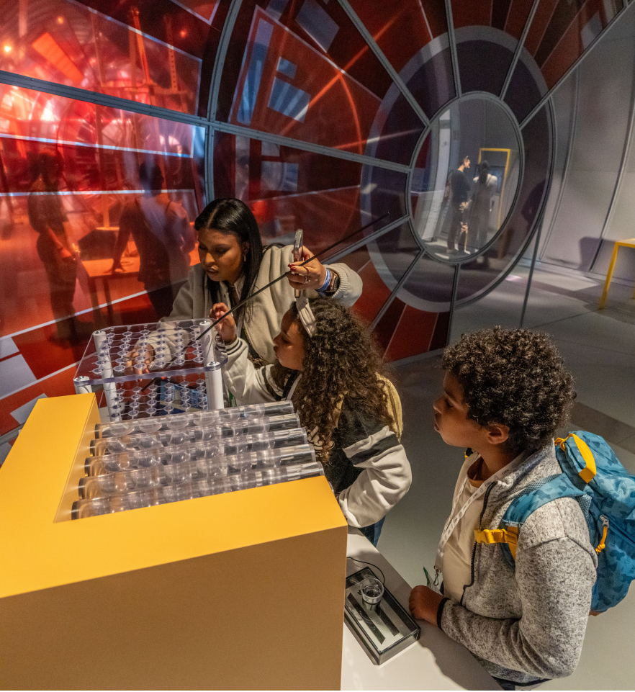
Our Goals
Enable a diverse audience across all sectors of the public to engage with the science, the discoveries, the technologies and the people working at CERN
Inspire the next generation to explore a career in science and technology
Empower visitors of all ages to make sense of the science that shapes their lives
Conserve and display the heritage of big science, the objects and stories that transmit the tremendous human endeavour in a tangible way.
Build ties across CERN Member States and beyond, encouraging co-creation with other museums, science centres, cultural centres and education networks.

Slide 18
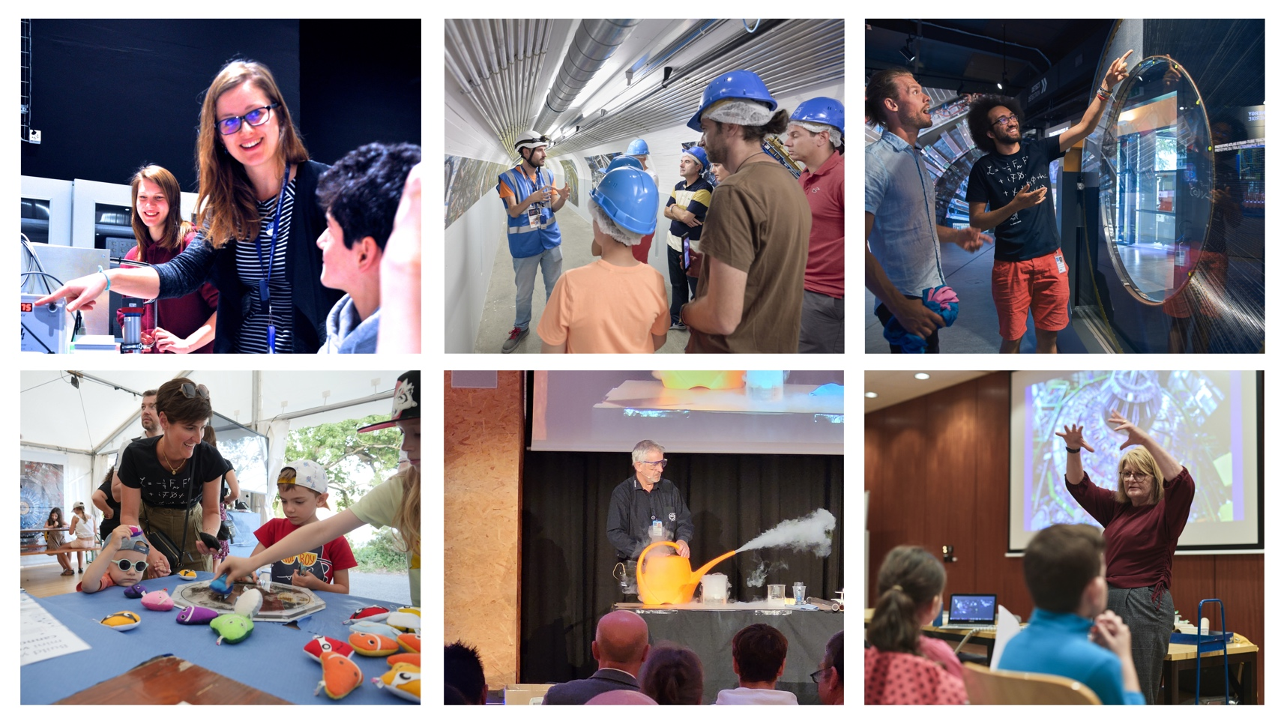
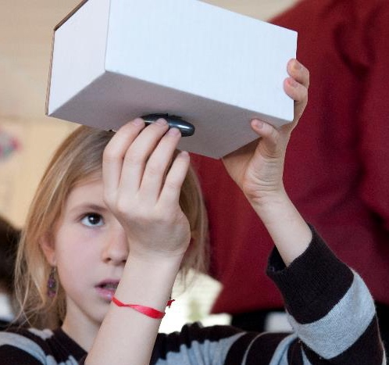
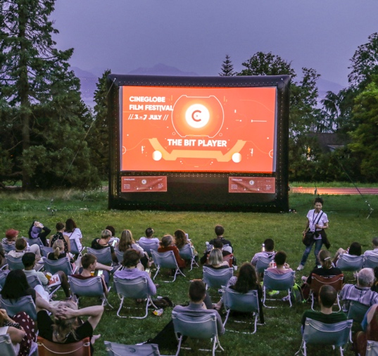
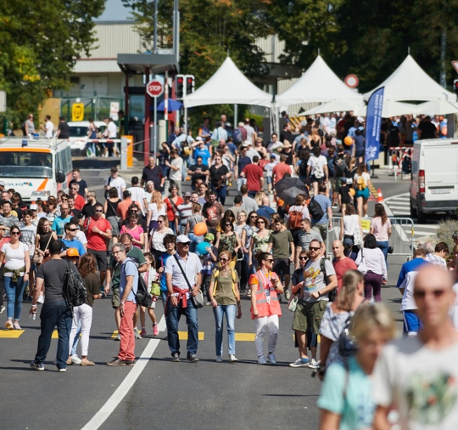
Outreach activities at CERN
At CERN average yearly figures
Permanent exhibitions 400’000 visitors
Guided tours 150’000 visitors
Lab workshops 27’000 participants
Science shows thousands of participants
Public events 7’000 participants / 10 events
Temporary exhibitions (ongoing)
Open days Every 5/6 years,
75’000 visitors in 2 days
In the local area and in the world
Passport to the Big Bang
Local area activities
Travelling exhibitions
Virtual visits

Slide 19
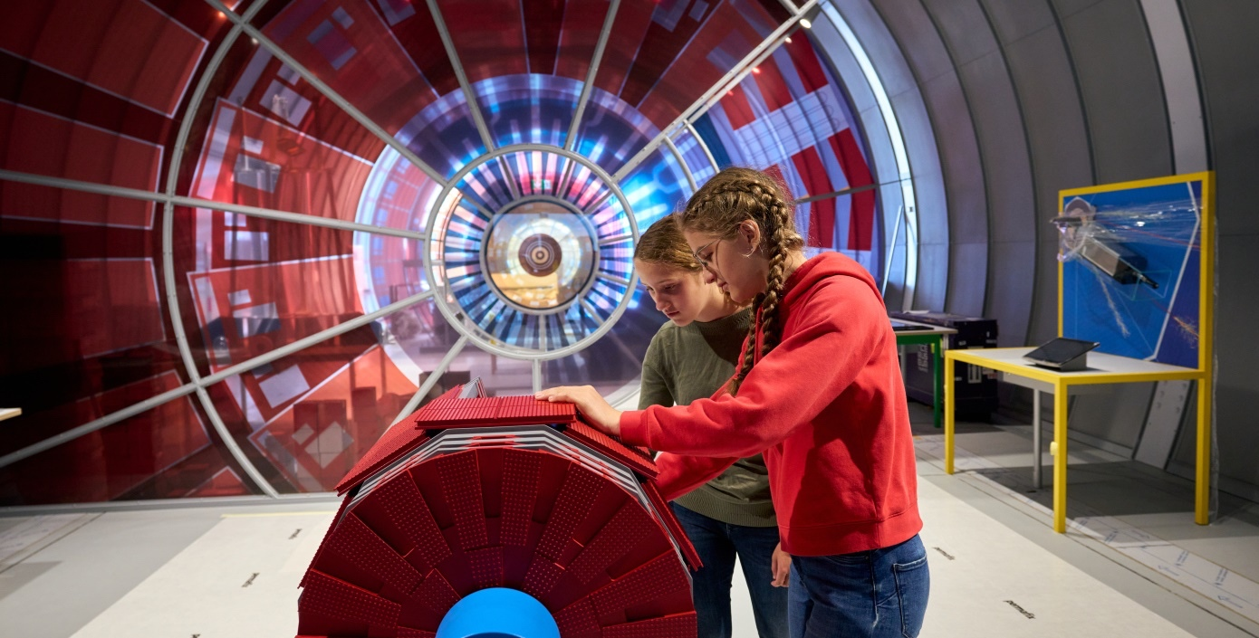
Interactive
exhibitions
From 8 years old
2 to 3 hours of activity
  Discover CERN
  Our Universe
  Quantum World

Slide 20
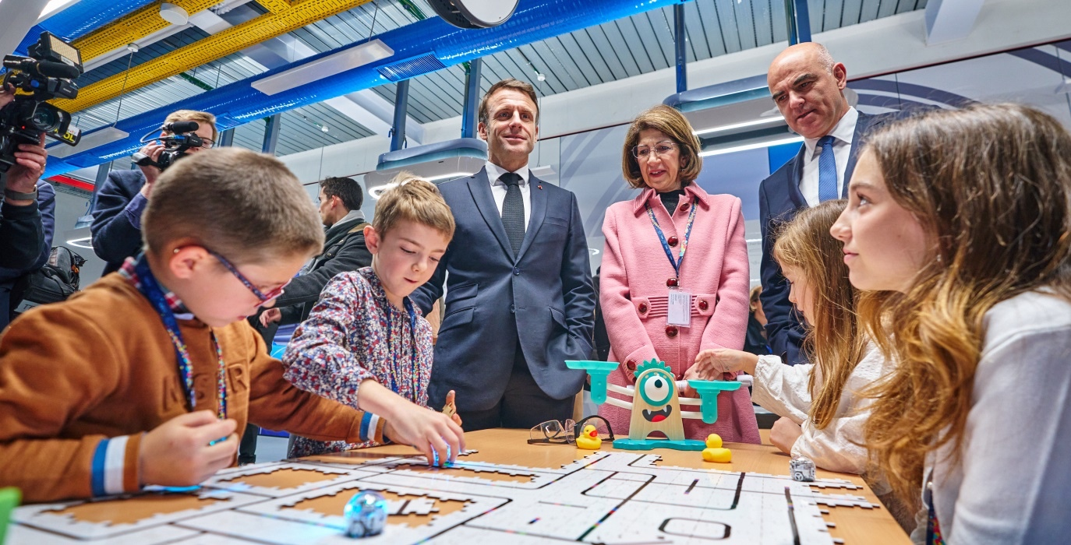
Lab workshops
From 5 years old
45 minutes
  Seeing the invisible
  Robotics
  Magnetism
  Power of the air
  Detectors etc.

Slide 21
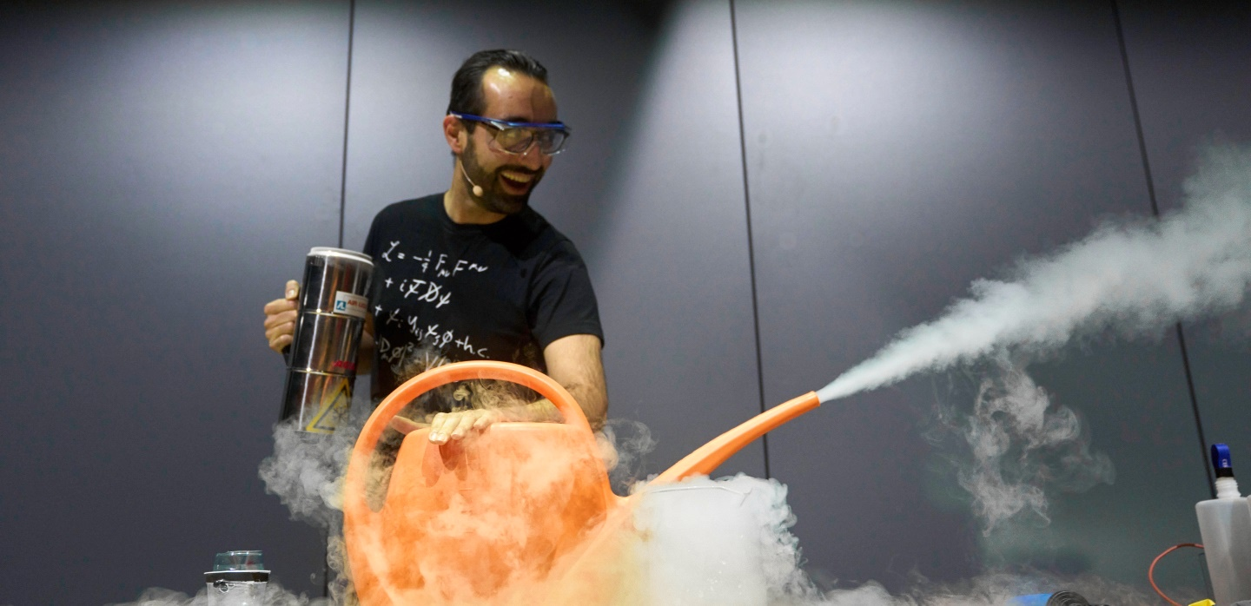
Science shows
From 4 years old
45 minutes
  States of matter
  Cryogeny
  Magnetism
  Big data etc.

Slide 22
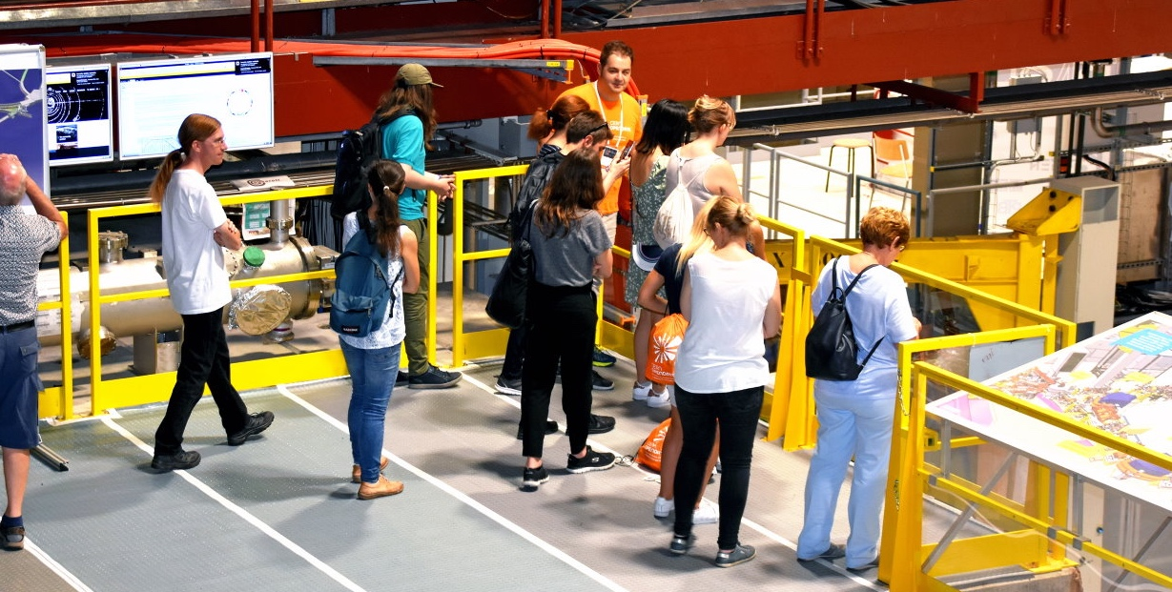
Guided tours
From 12 years old
90-180 minutes
  Surface visits
  Underground visits
  (rarer, in Winter only)

Slide 23
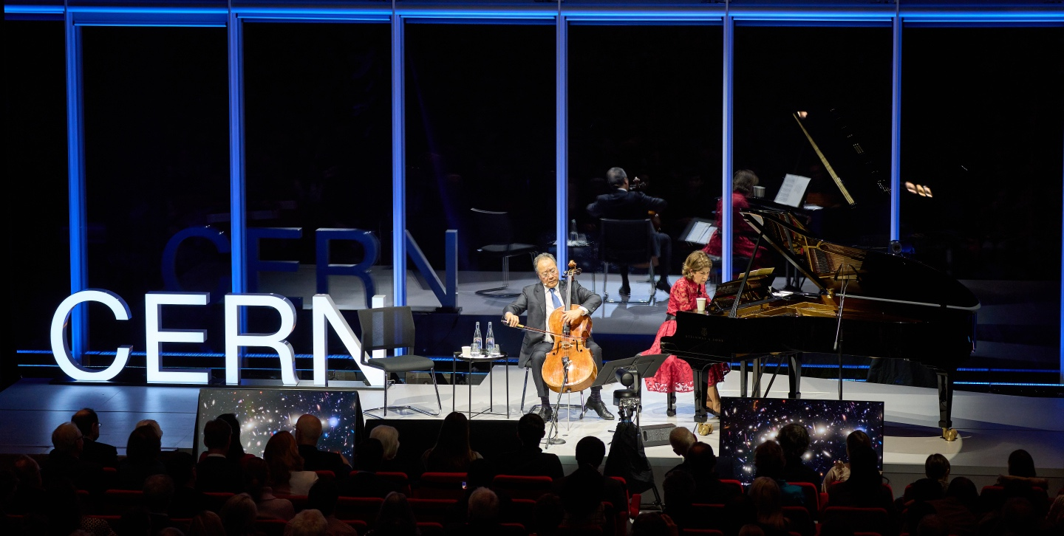
Public events
Conferences
Film screenings
Artistic performances
Film festivals
Etc.

Slide 24
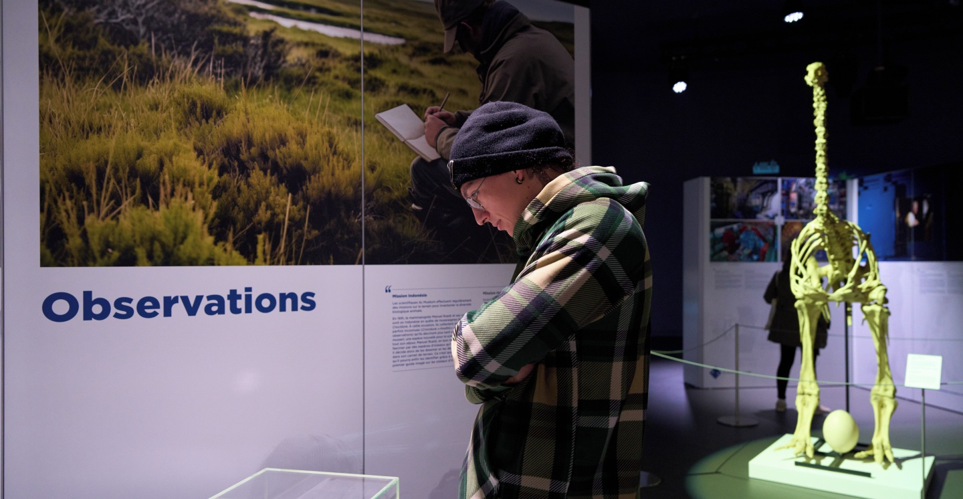
Temporary exhibitions
19 Oct 2024 – 02 Mar 2025 : Curious connections in collaboration with Geneva Natural History Museum
So far, 23% of Science Gateway visitors have visited it

Slide 25
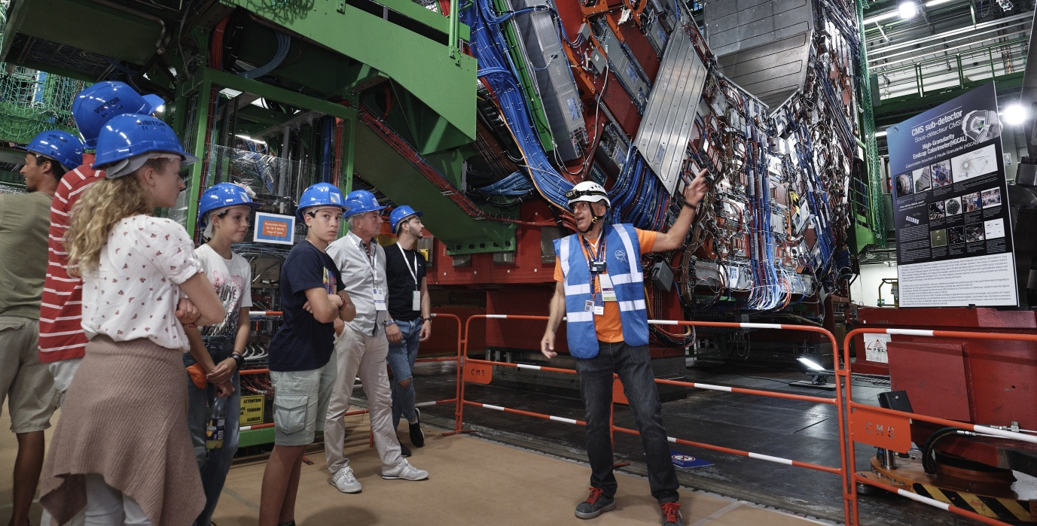
Open days
Every 5-6 years
75’000 visitors

Slide 26
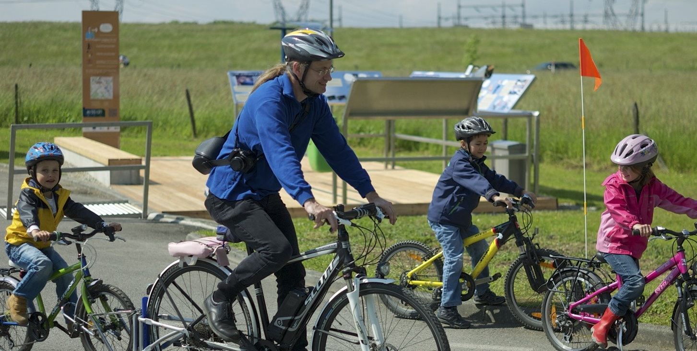
Passport to the Big Bang
Freely accessible
54 km of biking trail 100m over the LHC path
10 interactive stages
Ca 25’000 visitors over the past 5 years

Slide 27
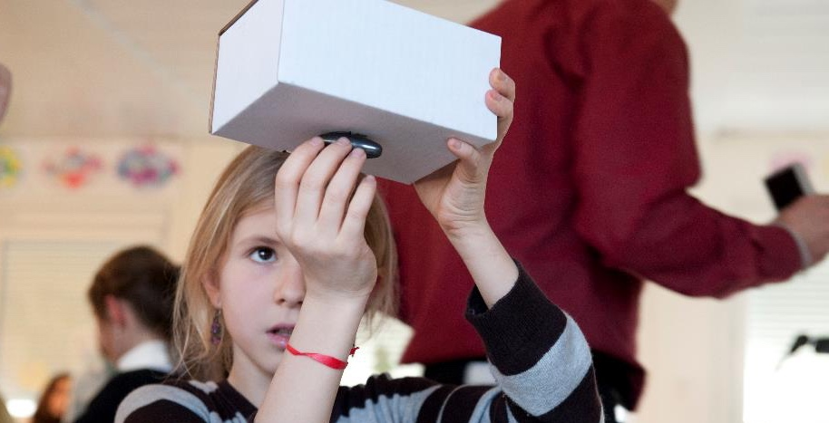
Local area activities
Local schools programmes
Local science fairs
Local conferences

Slide 28
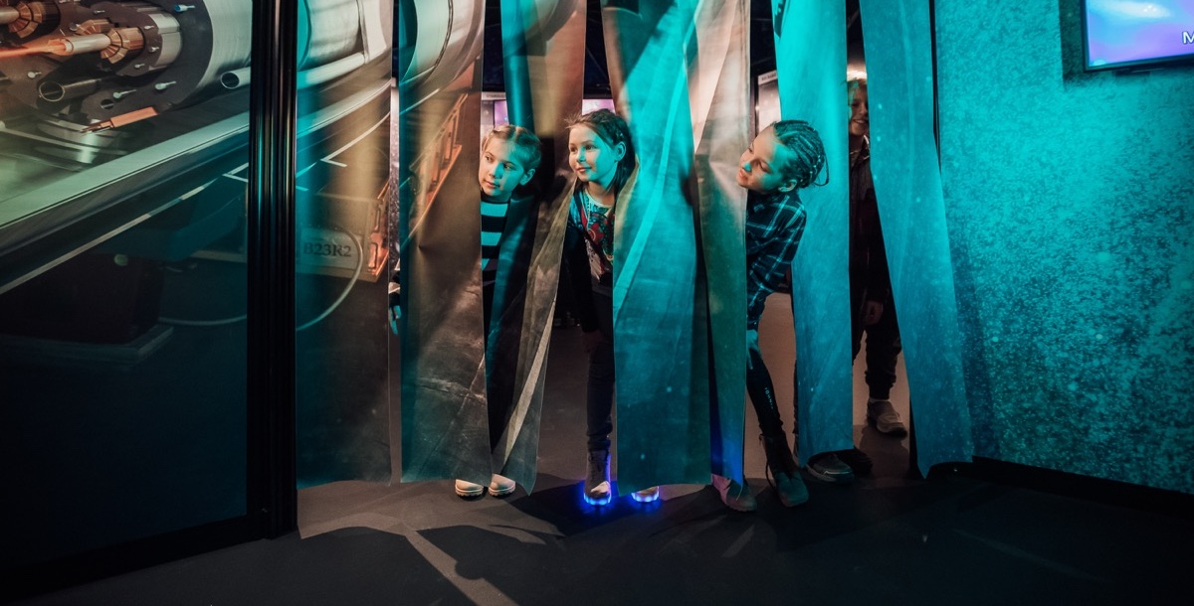
Travelling exhibitions
Exhibitions on CERN and its missions
Interactive activities

Slide 29
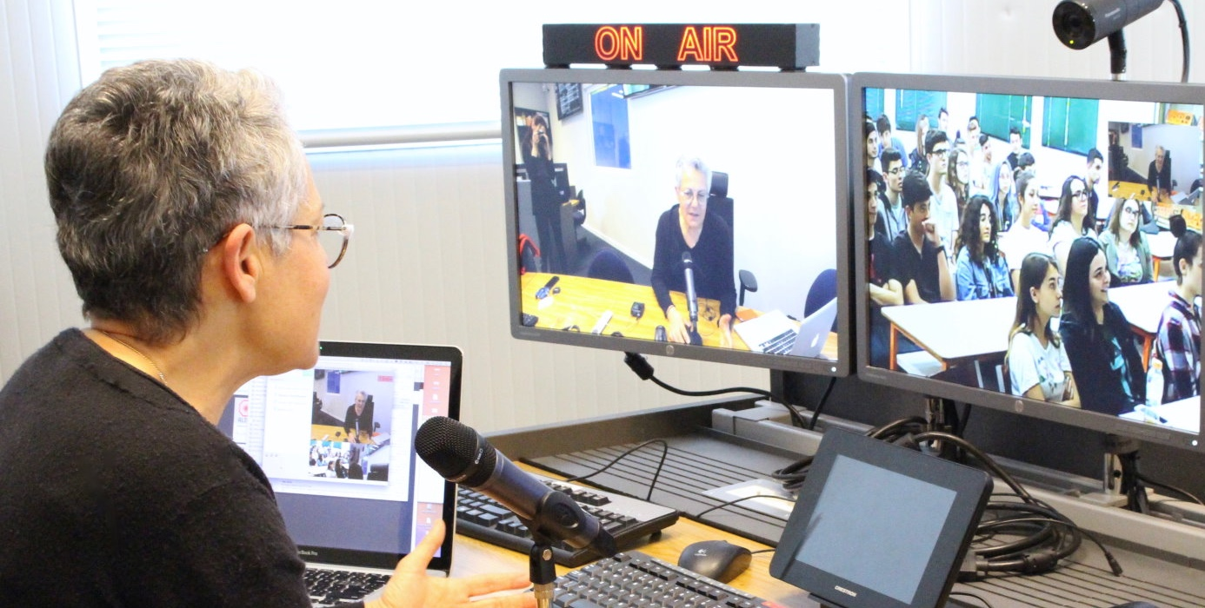
Virtual tours
Virtual talk or tour of real science places (detectors, accelerators, data centre etc.)

Slide 30

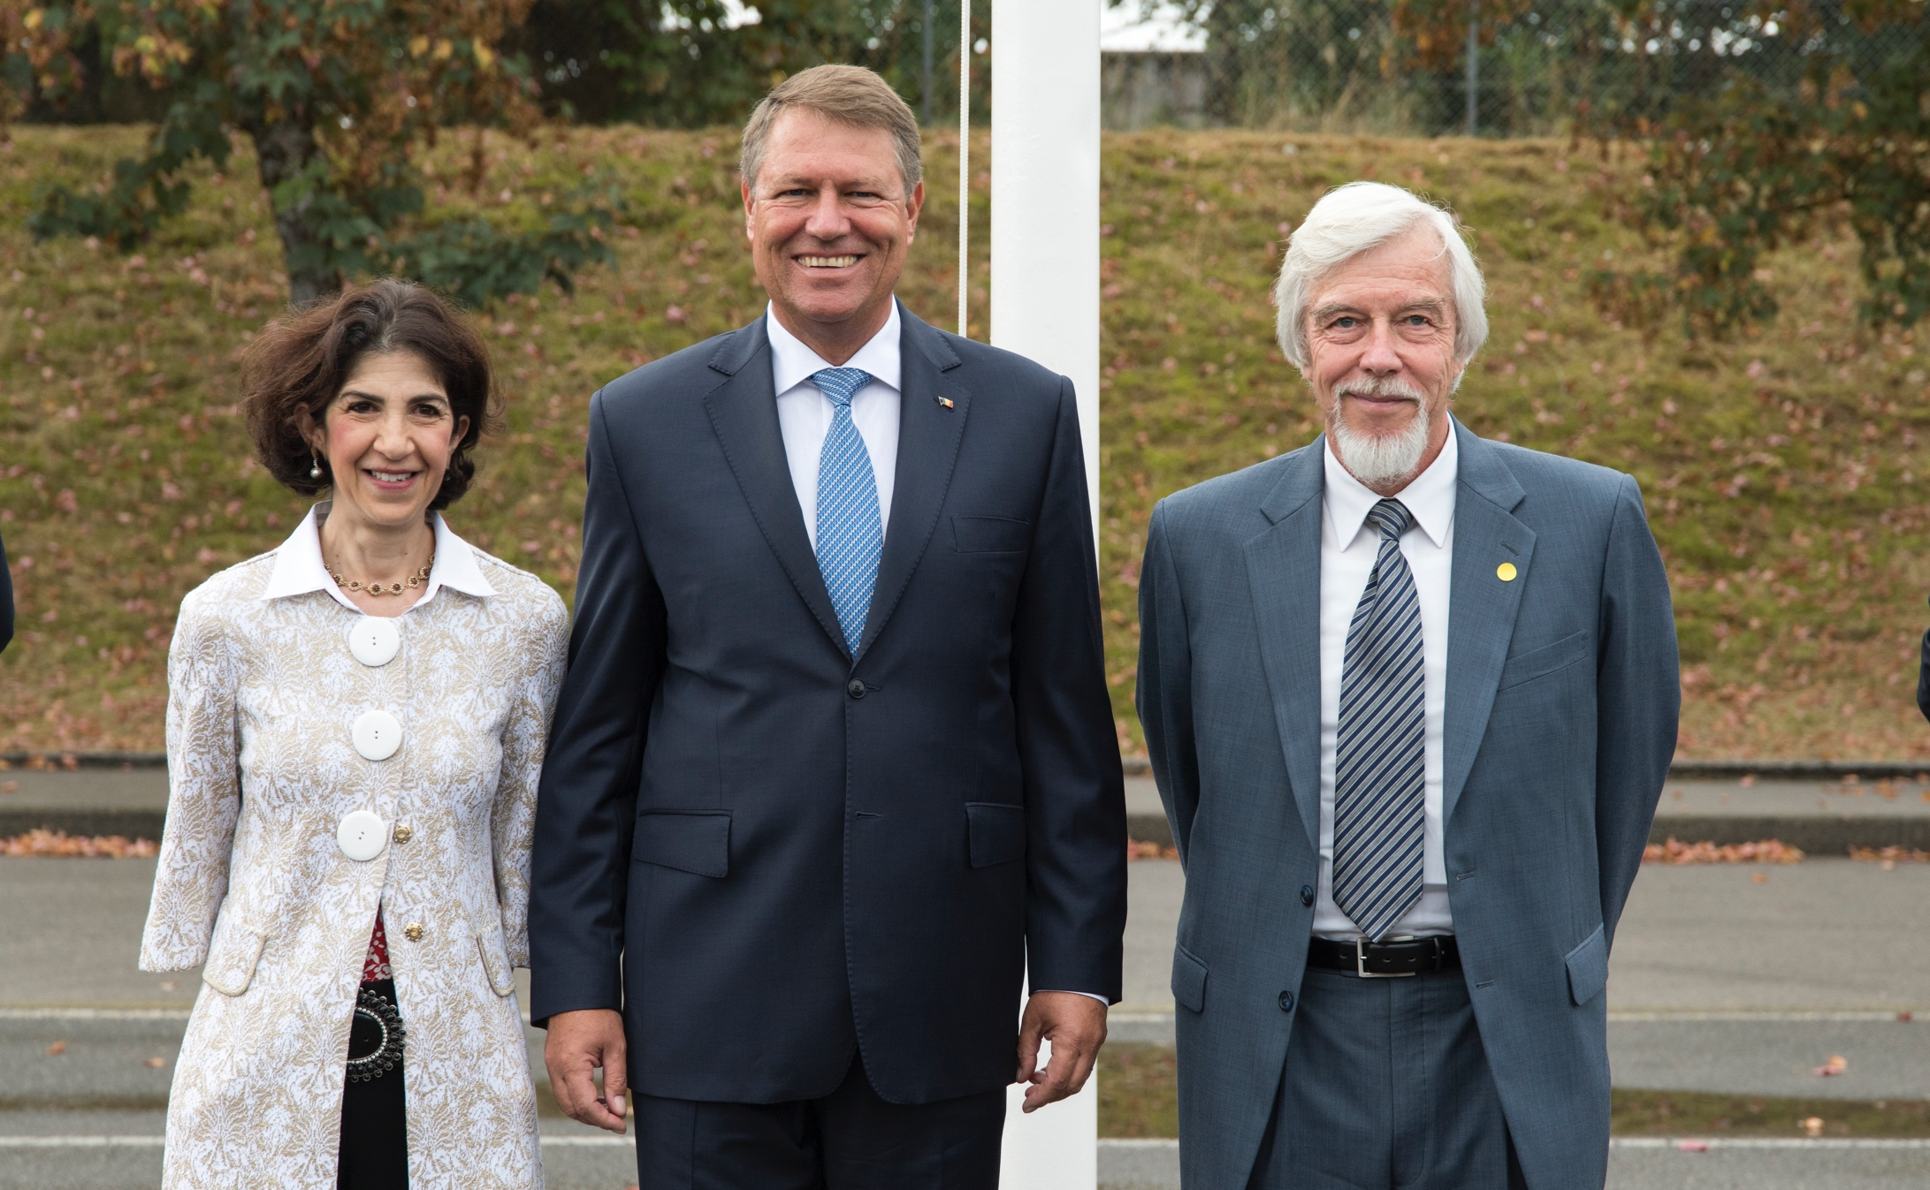
Romania and CERN
Since the early 1990s direct collaboration with CERN
December 2008: CERN Council granted Romania the status of Candidate for Accession to Membership
11 February 2010: Romanian Minister of Education, Research, Youth and Sport, Daniel Petru Funeriu, and CERN Director General, Rolf Heuer, sign an agreement that formally recognizes Romania as
a Candidate for Accession to Membership of CERN.
13 October 2010: agreement was unanimously ratified by the Romanian parliament.
Romania became CERN’s 22nd Member State on
17 July 2016.
His Excellency Mr Klaus Werner Iohannis President of Romania on the occasion of the
flag-raising ceremony to mark the accession of Romania as a Member State of CERN

Slide 31
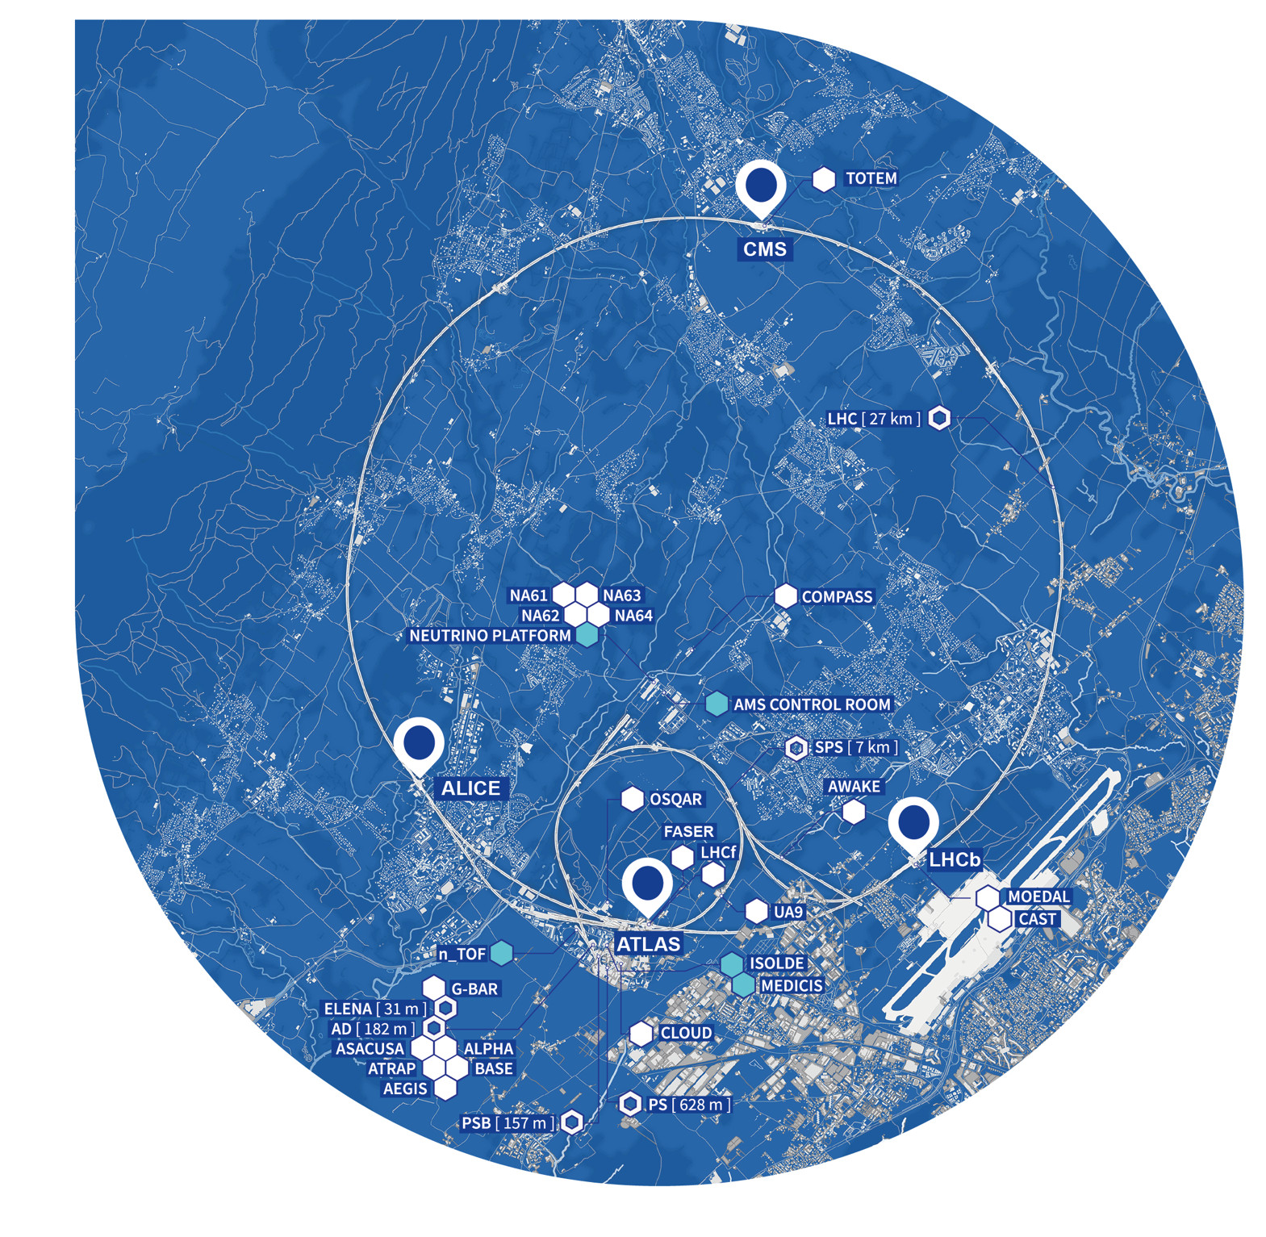
Romania has a strong involvement across the whole of the CERN experimental programme
LHC EXPERIMENTS:
ALICE 3 Institutes, 30 Participants
ATLAS 6 Institutes, 66 Participants
LHCb 1 Instituts, 14 Participants
OTHER LHC EXPERIMENTS
MoEDAL 1 Institutes, 4 Participants
FIXED TARGET EXPERIMENTS
nToF
NA62
Neutrino Platform
2 Institutes, 13 Participants
ISOLDE
1 Institute, 35 Participants
Significant contributions to detectors, readout electronics, GRID computing,
data analysis and physics, scientific outreach.

Slide 32
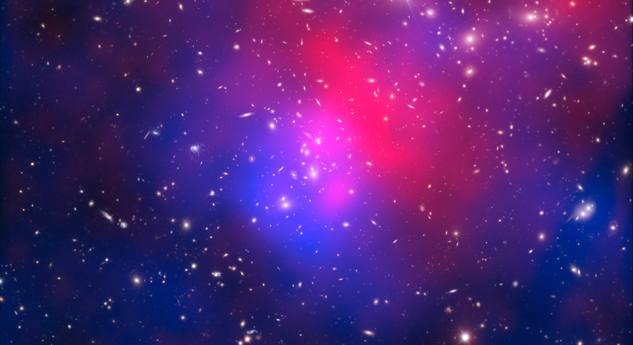
There are many unanswered questions
in fundamental physics
CERN, with you, will continue to play a crucial role in the journey of exploration, and on its way will fulfill its mission of education and outreaching.

