Slide 1
MINISTRY OF RESEARCH, INNOVATION AND DIGITALIZATION
INSTITUTE OF ATOMIC PHYSICS
Executive agency for funding research
of strategic interest in physics and related areas
Participation of Romania in CERN experiments
Măgurele-Bucharest
15 November 2024

Slide 2
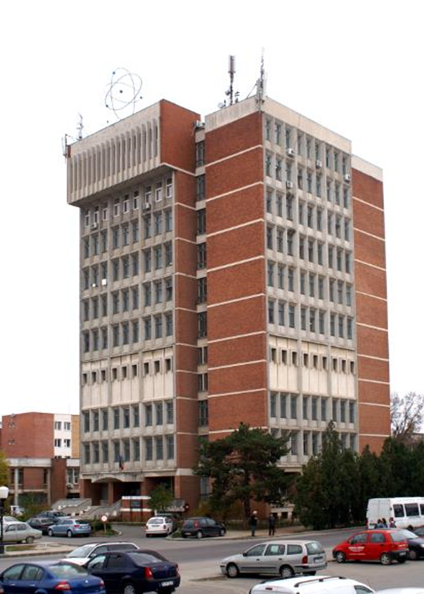
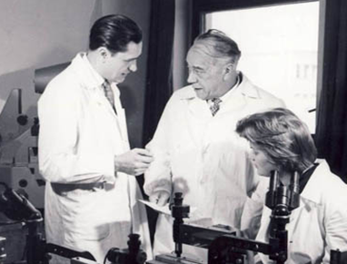
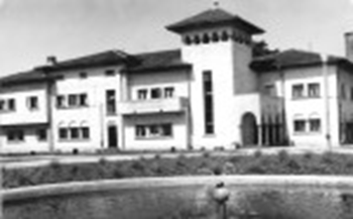
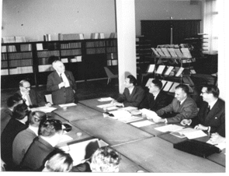
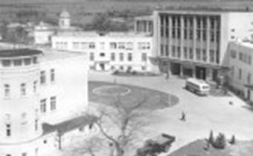
: from the cradle of the Romanian physics research
68th anniversary
2024 QT
to funding agency and integrating role
2022 DFG
2016 AUF & JINR
2014 ELI-NP & FAIR
2012 EURATOM Fission
2011 CERN
2010 F4E
2009 CEA / Appl. host. ELI
2008 Re-organisation
International cooperation and programme management in areas of strategic interest
2005 CEEX (-> 2008)
2001 CERES (-> 2006)
Horia Hulubei (1896-1972)
IFA founding father
2000 EURATOM Fusion (CORINT)
1996 National R&D Institutes
IFIN-HH, INFLPR, INFM, INFP spun off from IFA
1990 IFA (CSEN, ICEFIZ -> IFA), IRNE -> Min. El. Energy
1977 ICEFIZ (Re-organisation): IFA, IFB, CMS, Astr. Observatory
IFIN, IFTAR, IFTM, CFPS, CASS, FAN, IRNE Pitești,
ITIM Cluj-Napoca, CFT Iaşi
1973 ICEFIZ: IFA, ITN Pitești, I. Iz. St. Cluj, IFB, INCREST, Lab. Fiz. CCTF Iași
1968 IFA → CEN
1956 IFA (Inst. At. Phys.)
IFB
1949 Inst. Phys. Acad.

Slide 3
IFA Programmes
)
ELI-RO (2014)
EURATOM-RO (2000)
F4E-RO (2010)
AUF-RO (2016)
CERN-RO (2011)
FAIR-RO (2014)
CEA-RO (2009)
IFA conducts research programmes in areas of strategic interest
National Strategy for Research, Innovation and Intelligent Specialization (SNCISI) - HG 933/2022;
National Plan of RDI 2022-2027 (HG 1188/2022).

Slide 4
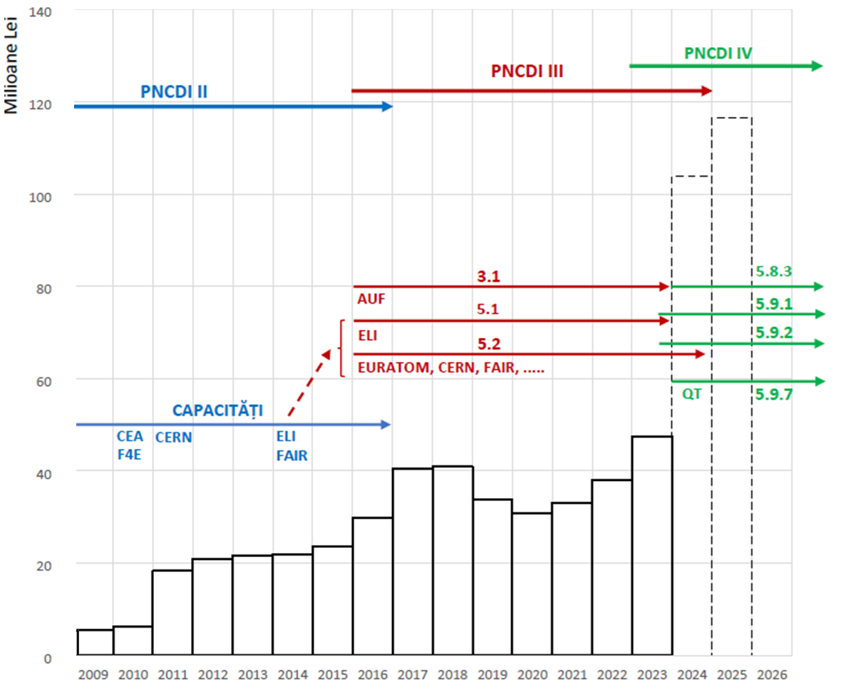
IFA Programmes Budget Evolution (2009-2025)
EURATOM

Slide 5
Current involvement in 11 CERN experiments
LHC:
Basic building blocks of matter; fundamental forces; Higgs boson;
physics beyond the Standard Model, super-symmetry.
Heavy-ion physics; strongly interacting matter at extreme energy densities; quark-gluon plasma.
antimatter asymmetry; "beauty quark“.
GRID computing
Magnetic monopole;
exotic particles.
Significant contributions to detectors, readout electronics, GRID computing, data analysis and physics
SPS:
PS:
Facility
Rare kaon decays; CKM mixing matrix.
Tau neutrino decay; lepton flavour universality.
Pulsed neutron source; neutron-nucleus interactions; time-of-flight measurements
Radioactive ion-beams; exotic nuclei; nuclear structure and models
Neutrino
Platform:
Neutrino physics
Hard semiconductor devices for very high luminosity colliders
ProtoDUNE-DP
R&D:

Slide 6
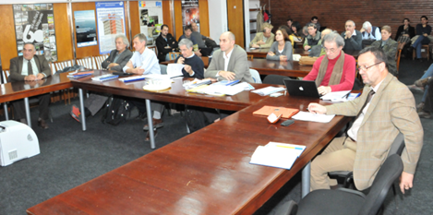
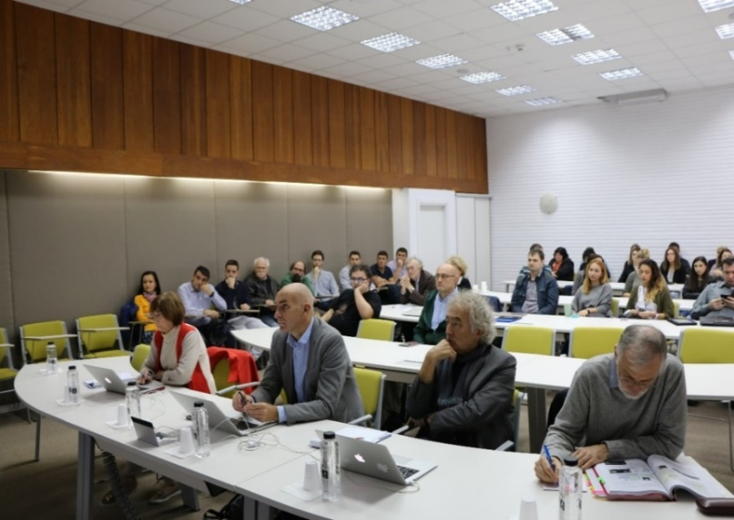
International Scientific Advisory Board
for evaluation of the CERN-RO projects
Members:
 | Dr. Cristinel DIACONU - Chair CPP Marseille, CNRS, France (2011)
 | Prof. John HARRIS Yale Univ., USA (2011)
 | Prof. Clara MATTEUZI INFN, Milano Univ., Italy (2015)
 | Prof. Thomas LOHSE Humboldt Univ., Germany (2016) Prof. María José García BORGE Consejo Superior de Investigaciones Científicas / Instituto de Estructura de la Materia, Spain (2023)
Former members:
Dr. Philippe BLOCH CERN Physics Dept. (2011-2017)
Prof. François LE DIBERDER Univ. Paris VII, France (2011-2014)
Dr. Eckhard ELSEN DESY, Germany (2011-2015) Dr. Christian JORAM CERN Physics Dept. (2019-2023)
November 2011 – 1st ISAB meeting
November 2018

Slide 7
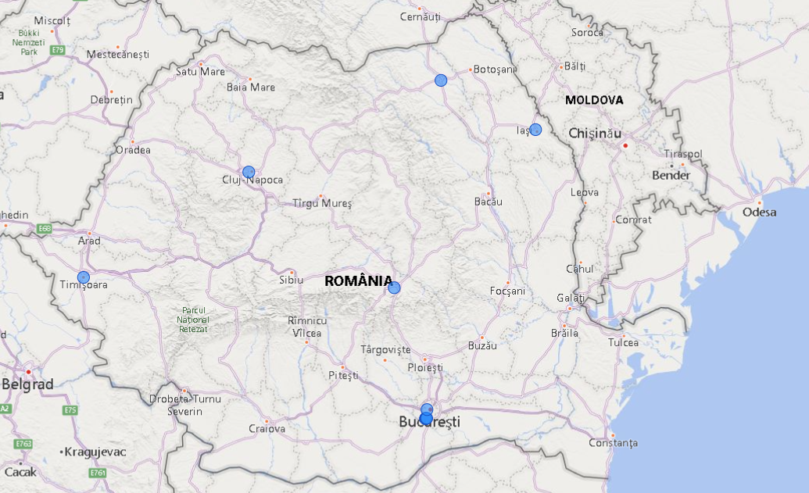
Romanian institutions participating in CERN experiments
Univ. Suceava
UAIC Iași
ITIM
UV Timișoara
UT Brașov
IFIN-HH
ISS
INFM
UPB
UB
4 National R&D Institutes and
6 Universities from 6 cities
4 Coordinators and 6 Partners
12 projects / 11 experiments
3 projects support activities

Slide 8
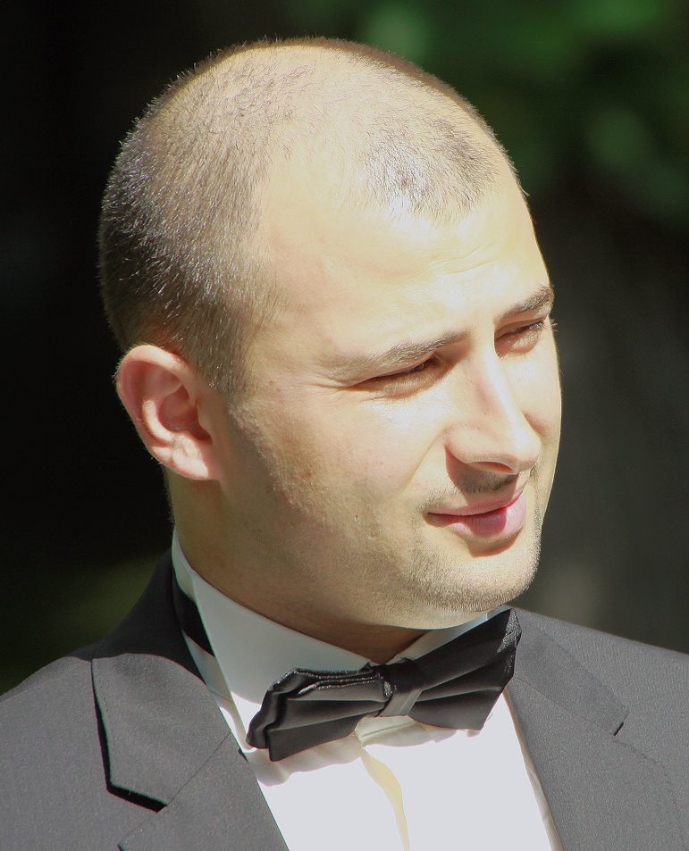
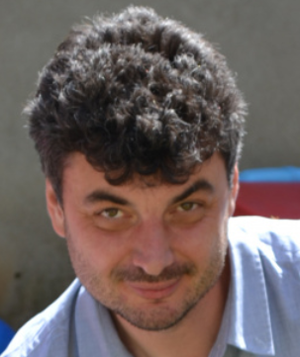
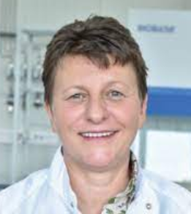
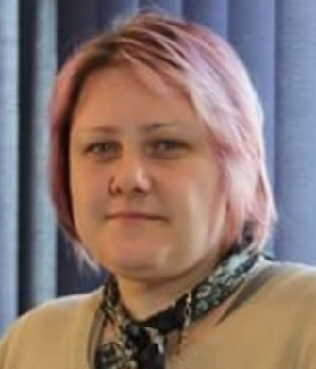
Team leaders
Prof. Mihai PETROVICI, IFIN-HH
Dr. Alexandru Florin DOBRIN, ISS
Prof. Călin ALEXA
IFIN-HH
Dr. Florin MACIUC
IFIN-HH
Dr. Mihnea DULEA
IFIN-HH
♰ Dr. Vlad POPA
ISS
Neutrino
Platform
Dr. Constantin MIHAI,
IFIN-HH
Dr. Alexandru Liviu
NEGREȚ, IFIN-HH
Dr. Alexandru-Mario
BRAGADIREANU, IFIN-HH
Prof. Ionel LAZANU
UB-FF
Dr. Ioana PINTILIE
INFM
Dr. Elena FIRU
ISS

Slide 9
Scientific Output & Funding of CERN-RO Projects
Average per year:
Human Resources > 100 Researchers
> 40 Young Researchers, PhD & Master Stud.
~ 50 Auxiliary R&D Personnel
Scientific Output > 200 ISI articles; > 100 conf. & workshops pres.
> 25 exp. models & transferred-developed tech.
Total: 256 MRON
(~55 MCHF)

Slide 10
Scientific Output & Funding of CERN-RO Projects National Plan III

Slide 11
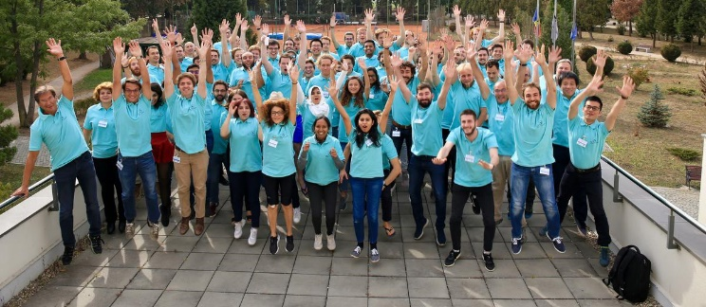
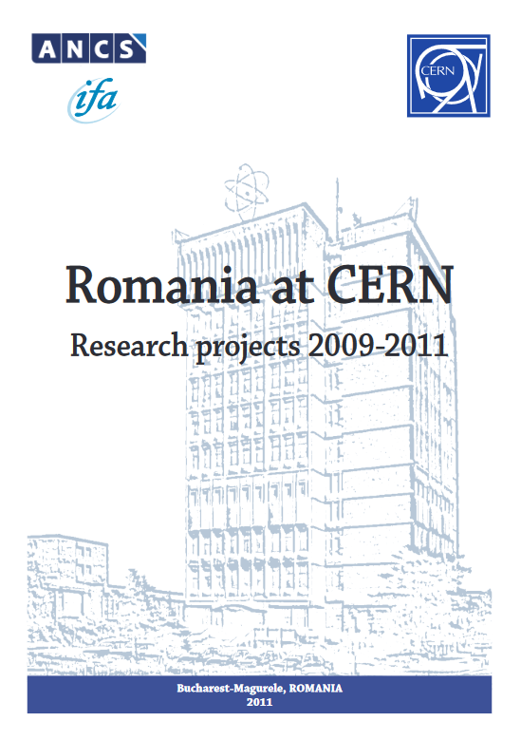
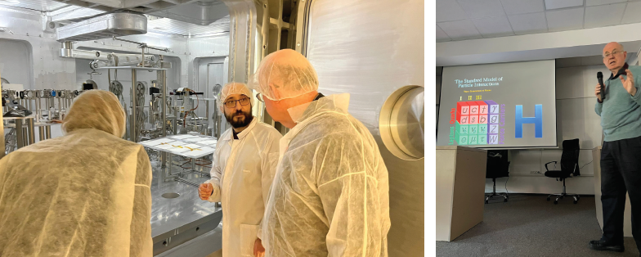
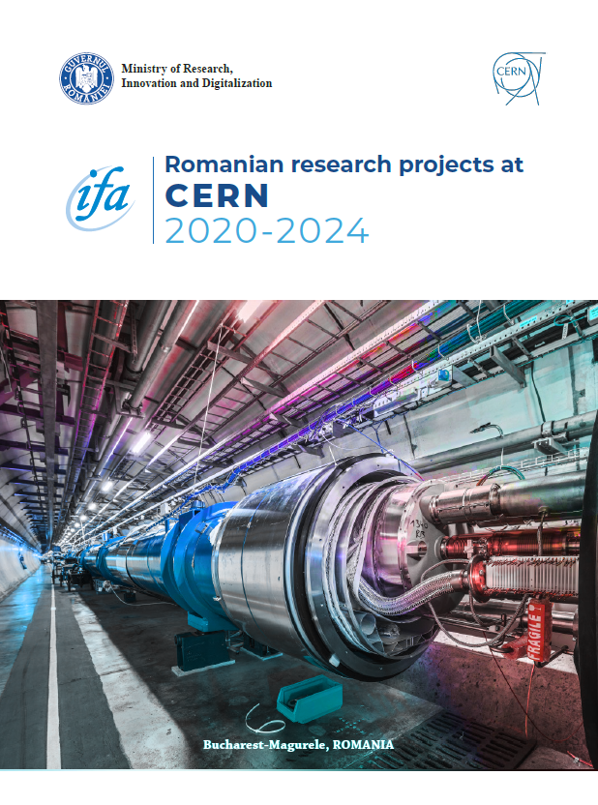
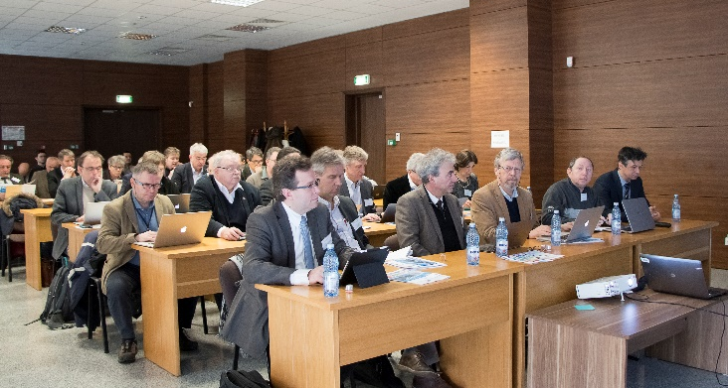
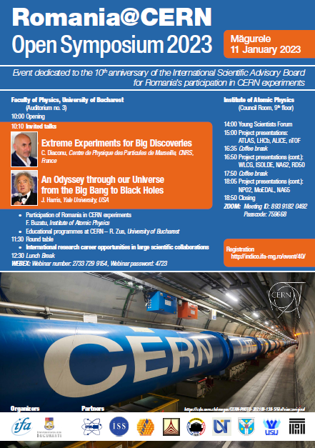
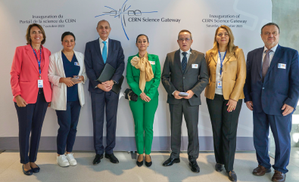
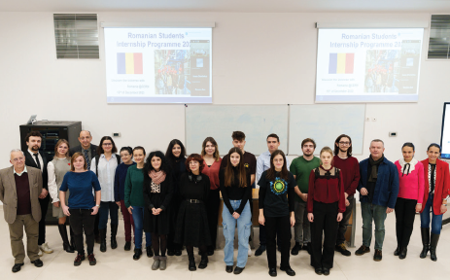
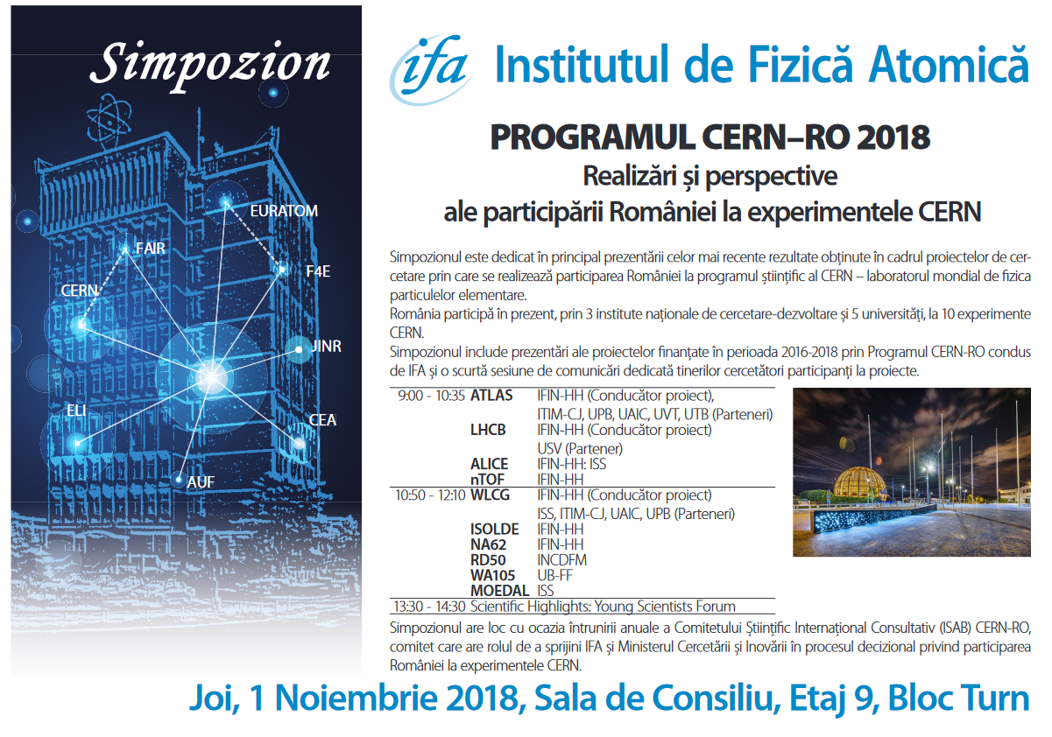
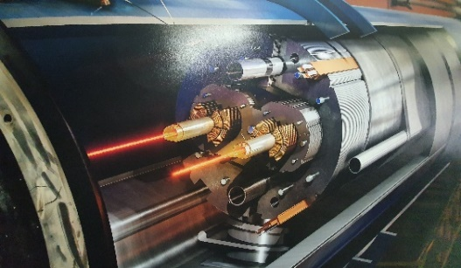
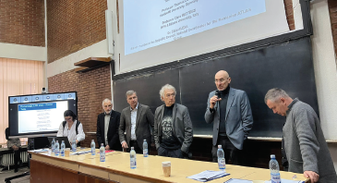
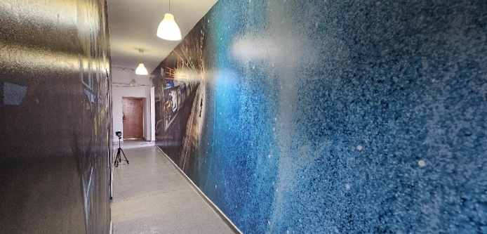
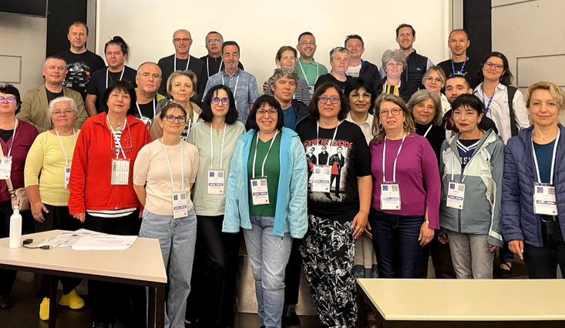
Dissemination & Outreach
2009-2011
……
CERN School of Computing 2019,
Cluj-Napoca/UBB
Prof. RABINOVICI visit in
RO, 2023
ECFA visit in Romania/IFIN-HH 2018
CERN Science Gateway, 2023
……
DUROCERN Project
2023-2024
Romanian Teacher
Programme (RTP) 2024
Romania@CERN
Open Symposium 2023

Slide 12
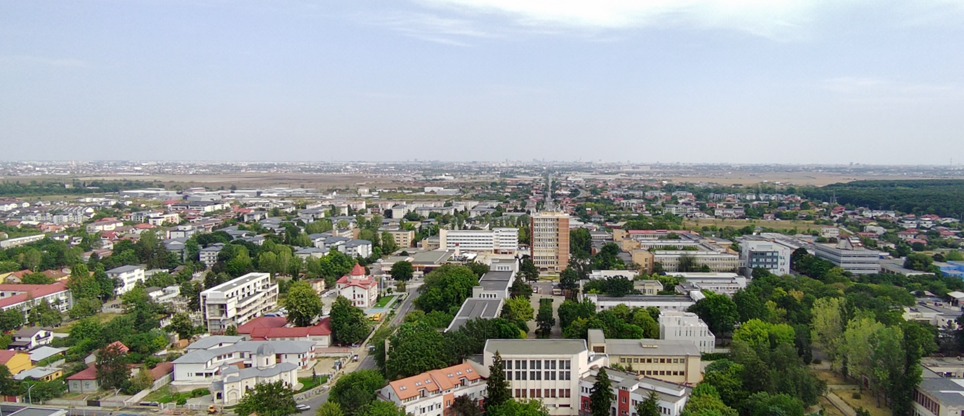
Thank You!
www.ifa-mg.ro

